Slide 1
E-mail Requesting Approval
CAUTION: This is an EXTERNAL email. Do not click links or open attachments unless you recognize the sender and know the content is safe.
Hi William,
A position description for the HR Generalist - Position Description Number: 59429 has been sent to you for approval.
You can approve or decline the position description or make changes before approving. Please discuss any changes with the Supervisor.
To review the position description, please click the following link to access the PageUp system:
View Position Description
Please Note: This is accessible by computer only. Non-COV network users please log in HERE and navigate to the Position Description library.
Kind regards,
Longwood University Recruitment Team
If Human Resources has received your EWP, you will receive this email from the following sender: “PageUp PD Approval”
You should have already created a PageUp password (instructions in previous email). If you haven’t, then reference the previous email and create a password. Once created, click on the blue link “HERE” highlighted in yellow above. Go to the next slide.

Slide 2
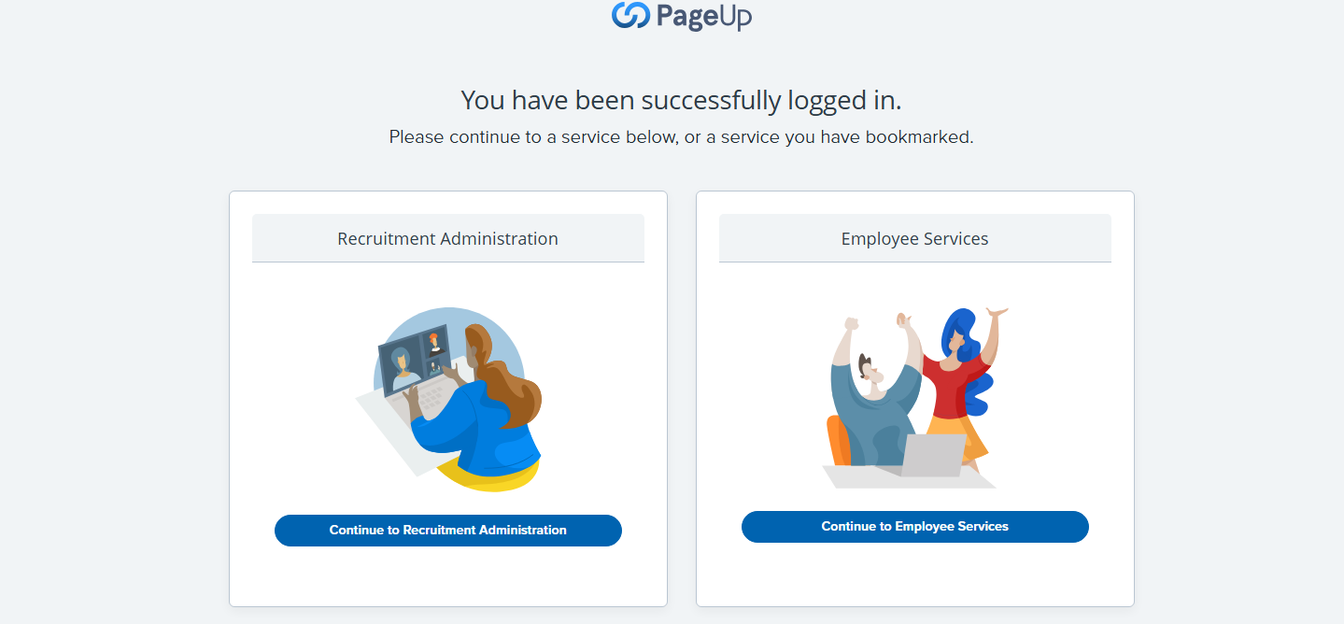
Page Up Landing Page
From here, click on “Recruitment Administration,” the link on the left which will take you to a dashboard. Go to the next slide.

Slide 3
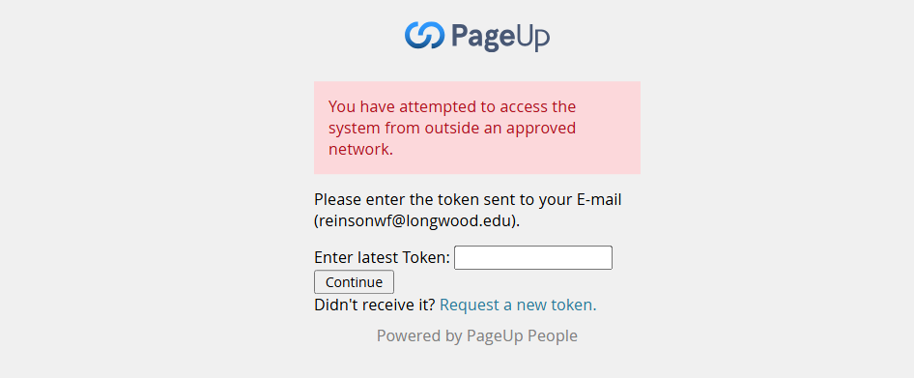
Security Token
The system automatically issues a security token. Check your email, copy the number, enter it in this box that appears on your computer and hit continue. Go to next slide.

Slide 4
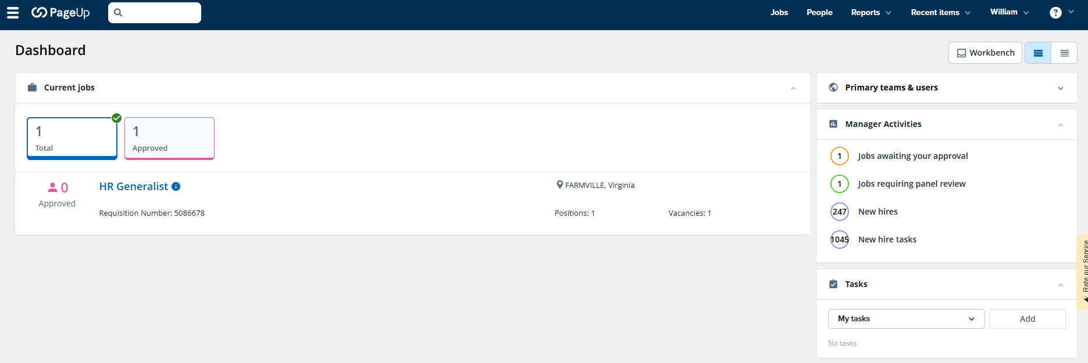
Jobs Awaiting Approval
In the box on the right, labeled “Manager Activities,” click on the link for “Jobs awaiting your approval.” Go to the next slide.

Slide 5
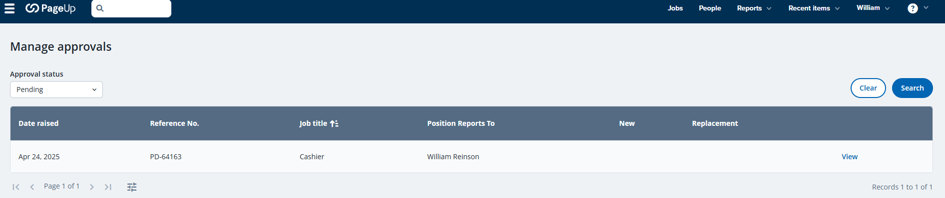
Manage Approvals
The job should appear on this screen with your name under “Position Reports To.” Click on the “View” button to the right of the job. Go to the next slide.

Slide 6
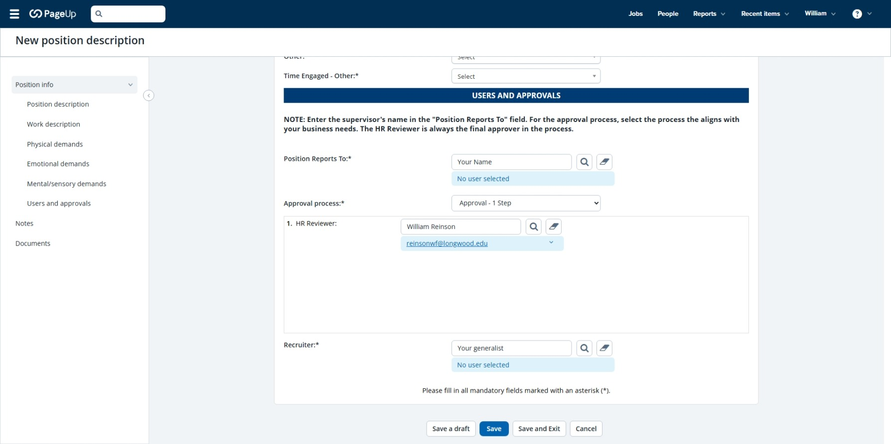
Note Before Beginning the Review
NOTE: If you need to stop during the process and return to complete it later, click on the “Save” box at the bottom of the page and exit the program. When you return, start back at slide #1 (sign in) of this slide show. When you arrive at slide #5, click on “View” and you should be able to continue where you left off.

Slide 7
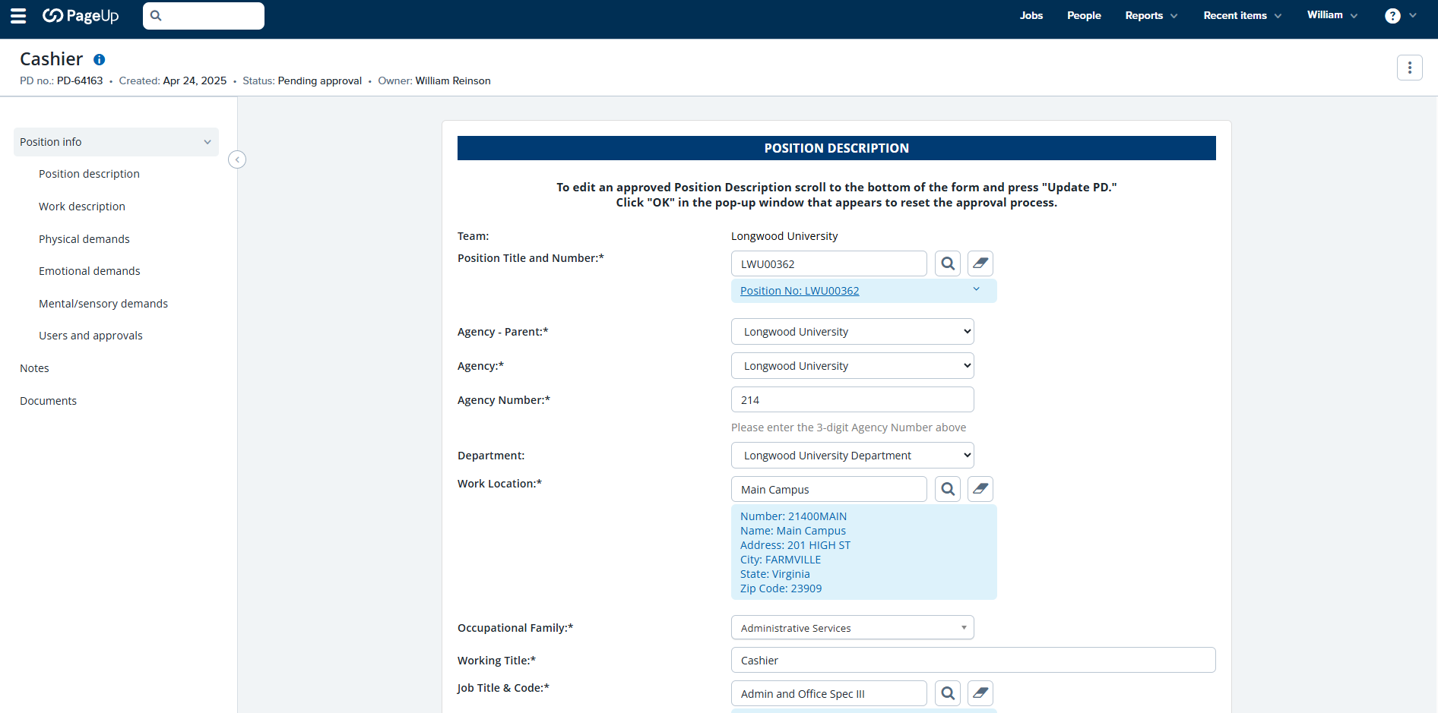
Reviewing the Position Description
The Position Description should appear with the information included. Please review all of the information (most of which is available on the EWP) to verify the accuracy. If you have a question about this information, please contact HR @ 2074. Go to the next slide.

Slide 8
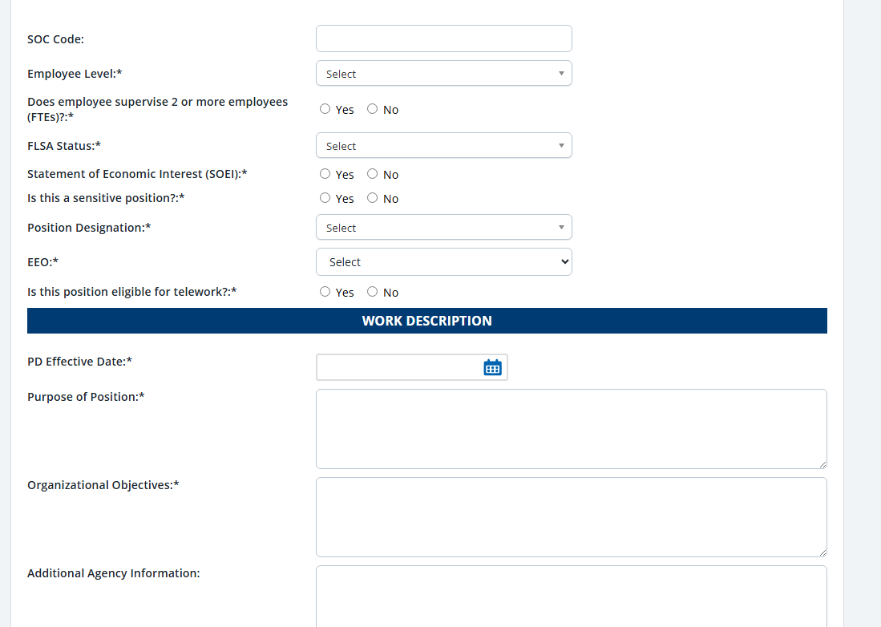
Reviewing the Position Description – Page 2
This information should already be included. Please review all of the information to verify accuracy. If you have a question about anything above the “Work Description” banner, please contact HR. The P.D. Effective Date should not be changed. If any of the information below the P.D. Effective Date is incorrect, you can make corrections. Go to the next slide.

Slide 9
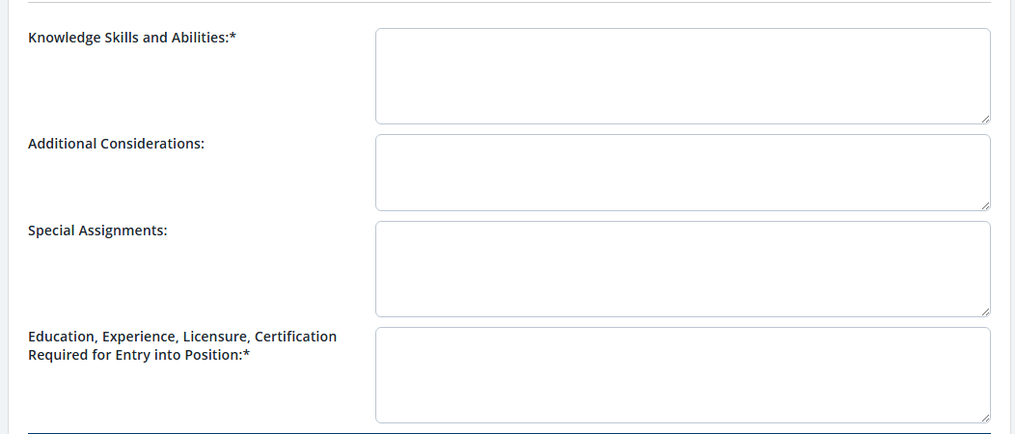
Reviewing the Position Description – Page 3
This information should already be included. Please review all of the information to verify accuracy. If any of the information is incorrect, you can make the corrections. Go to the next slide.

Slide 10
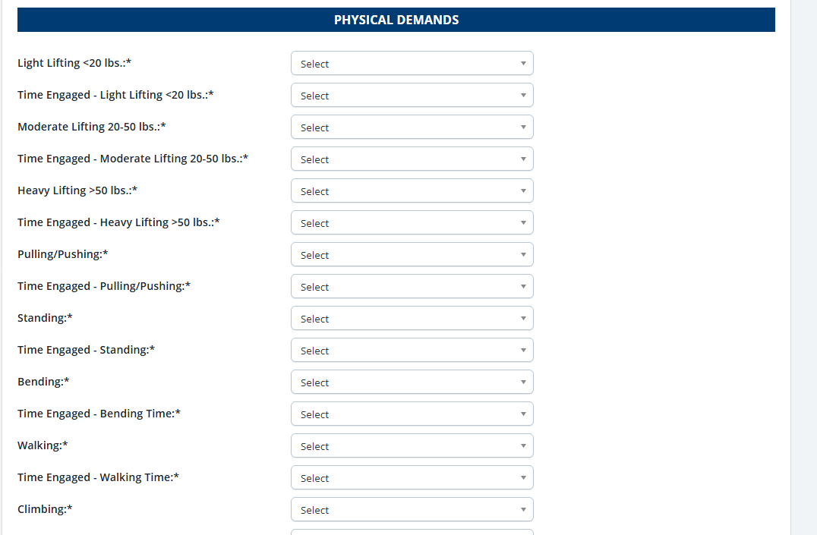
Reviewing the Position Description – Page 3
This information should already be included. Please review all of the information to verify accuracy. IMPORTANT. The selections in this section will be based upon the demands of an “HR Generalist” for an office type environment. If any of the demands for your position are different than those of an HR Generalist, click on the drop-down and select the response that applies. If you change something, make sure there is a selection in every box or the P.D. will not save. Go to the next slide.

Slide 11
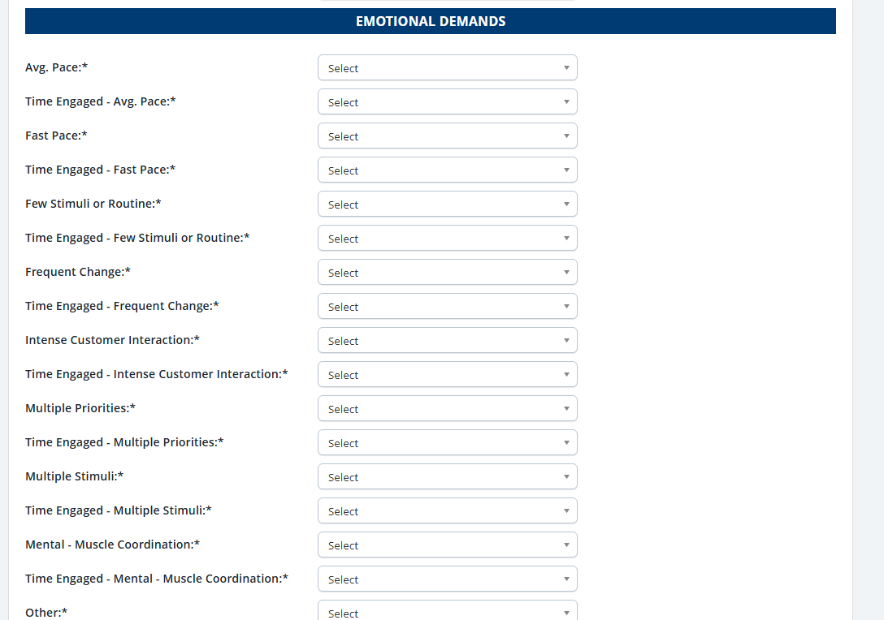
Reviewing the Position Description – Page 4
This information should already be included. Please review all of the information to verify accuracy. IMPORTANT. The selections in this section will be based upon the demands of an “HR Generalist” for an office type environment. If any of the demands for your position are different than those of an HR Generalist, click on the drop-down and select the response that applies. If you change something, make sure there is a selection in every box or the P.D. will not save. Go to the next slide.

Slide 12
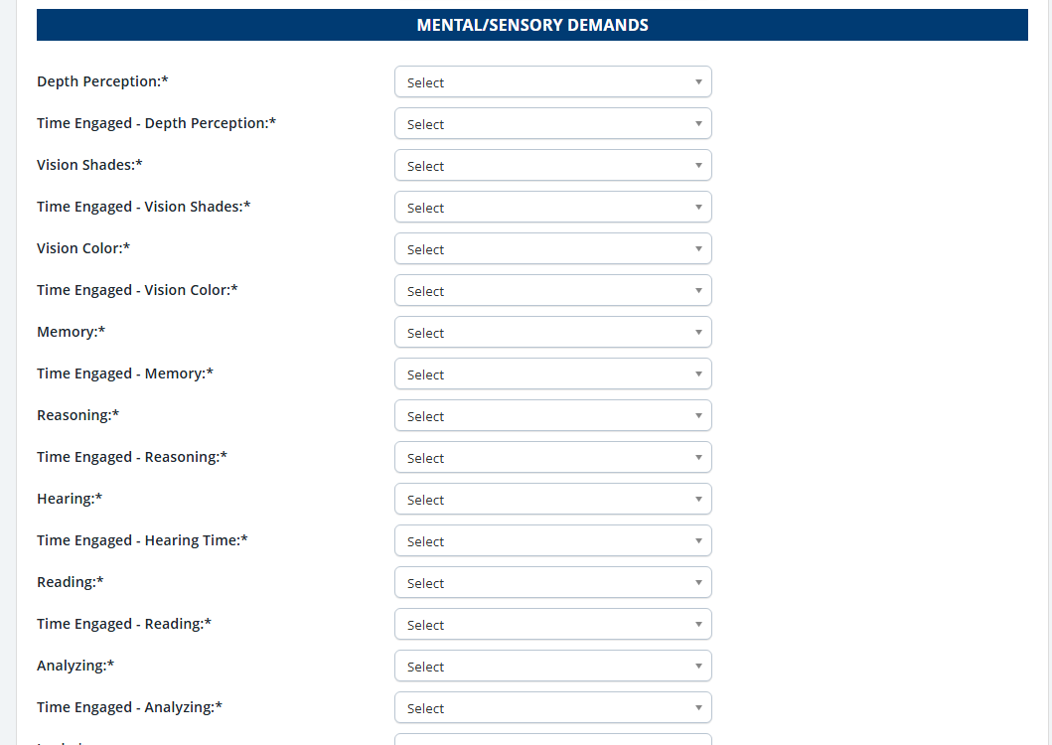
Reviewing the Position Description – Page 4
This information should already be included. Please review all of the information to verify accuracy. IMPORTANT. The selections in this section will be based upon the demands of an “HR Generalist” for an office type environment. If any of the demands for your position are different than those of an HR Generalist, click on the drop-down and select the response that applies. If you change something, make sure there is a selection in every box or the P.D. will not save. Go to the next slide.

Slide 13
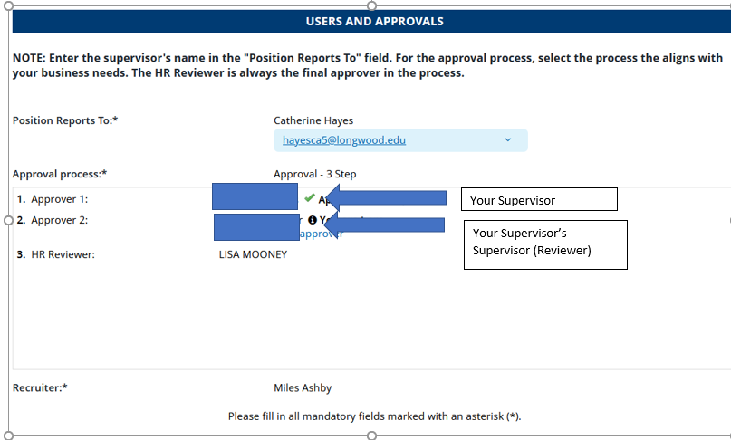
Approval
Your name should appear in the “Position Reports to” box. The Approval Process should include your Supervisor as “Approver 1” and your supervisor’s Supervisor (Reviewer) as “Approver 2”. And “Lisa Mooney” as “Approver 3”. Once you have reviewed the entire P.D., click on the “Approve” box and the P.D. will be forwarded to HR for final review. If HR makes any last minute changes, the P.D. will be returned to you for additional approval. Go to next slide.

Slide 14
Next Steps
Once the Position Description has received final approval, you will be able to begin the Employee Performance Profile for 2026. You will receive these instructions in a separate email shortly after completing the P.D.
If you have any questions throughout the process, please feel free to contact Human Resources at extension 2074 or email at humres@longwood.edu.

