Slide 1
Position Description Initial Screen
There are 21 slides in this presentation. These slides display a picture of the screen that you should see.
The instructions for each slide are bolded in a box at the bottom of the individual page. Please read the instructions as they are different for each page. Feel free to contact Human Resources if you have any questions.
Control and click to follow link
https://dhrm.login.pageuppeople.com/
In order to create an employee’s position description, control and click on the highlighted link which sends you to PageUp. Go to next slide.

Slide 2
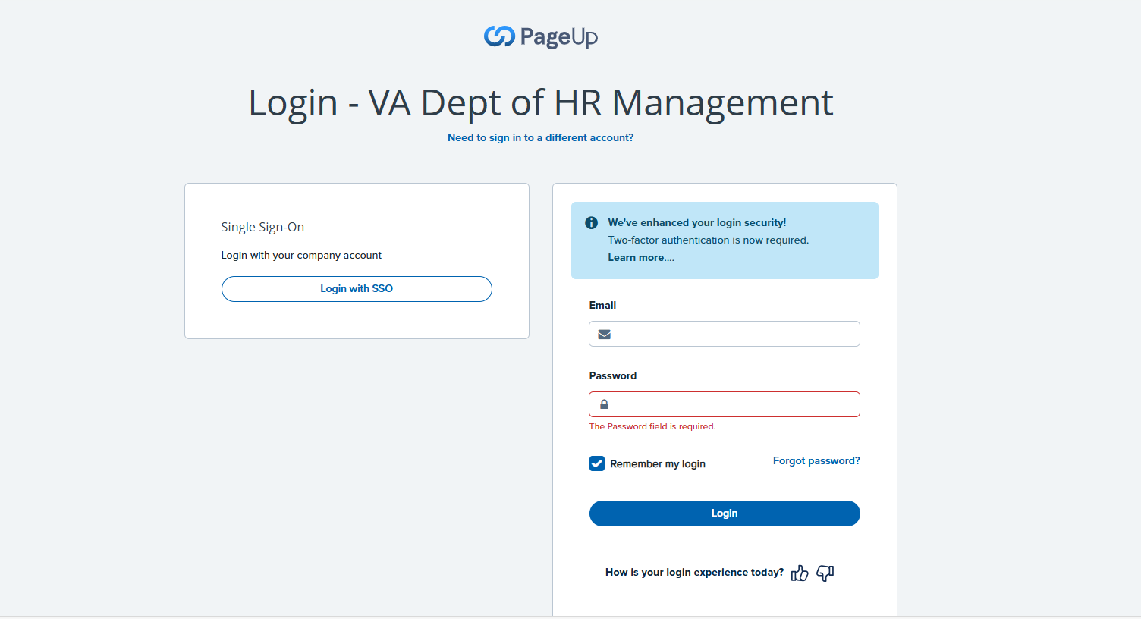
PageUp Login Screen
Enter your Longwood email address and your PageUp password into the box on the right. Go to next slide.

Slide 3
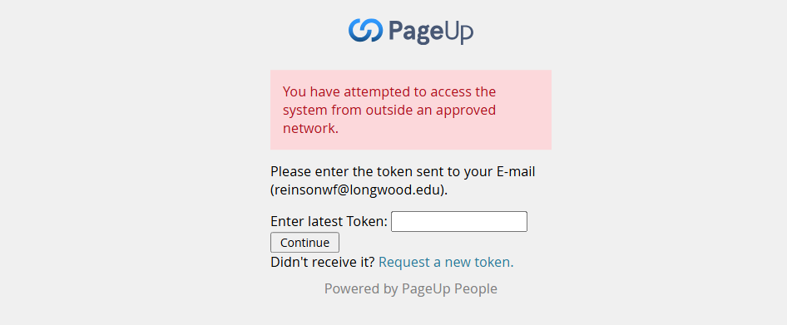
Security Token
The system automatically issues a security token. Check your email, copy the number, enter it in this box that appears on your computer and hit continue. Go to next slide.

Slide 4
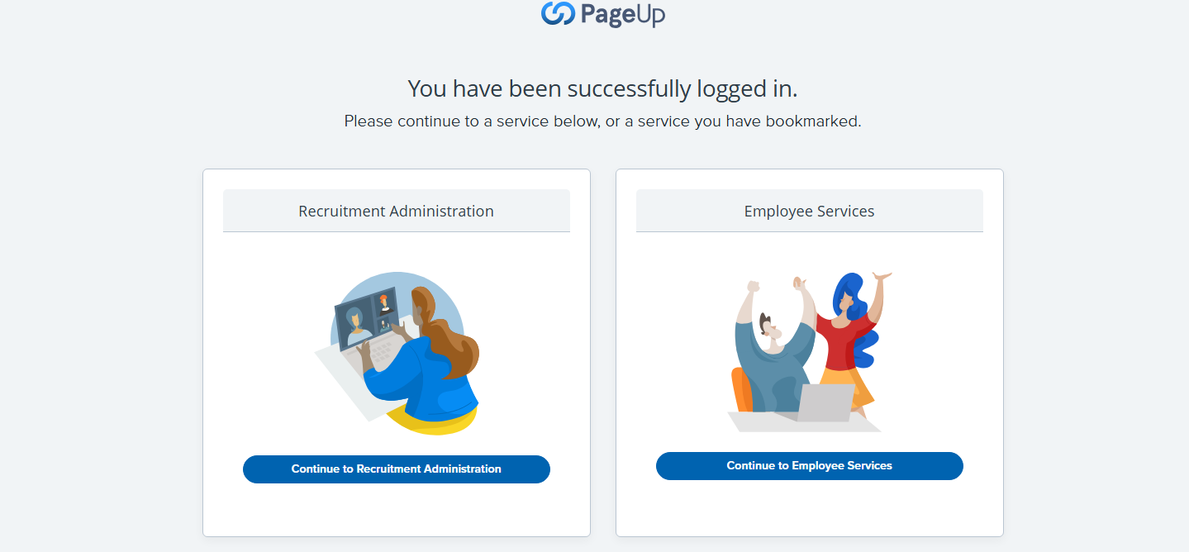
Page Up Landing Page
From here, click on “Recruitment Administration,” the link on the left, to check for the Position Description. Go to next slide.

Slide 5
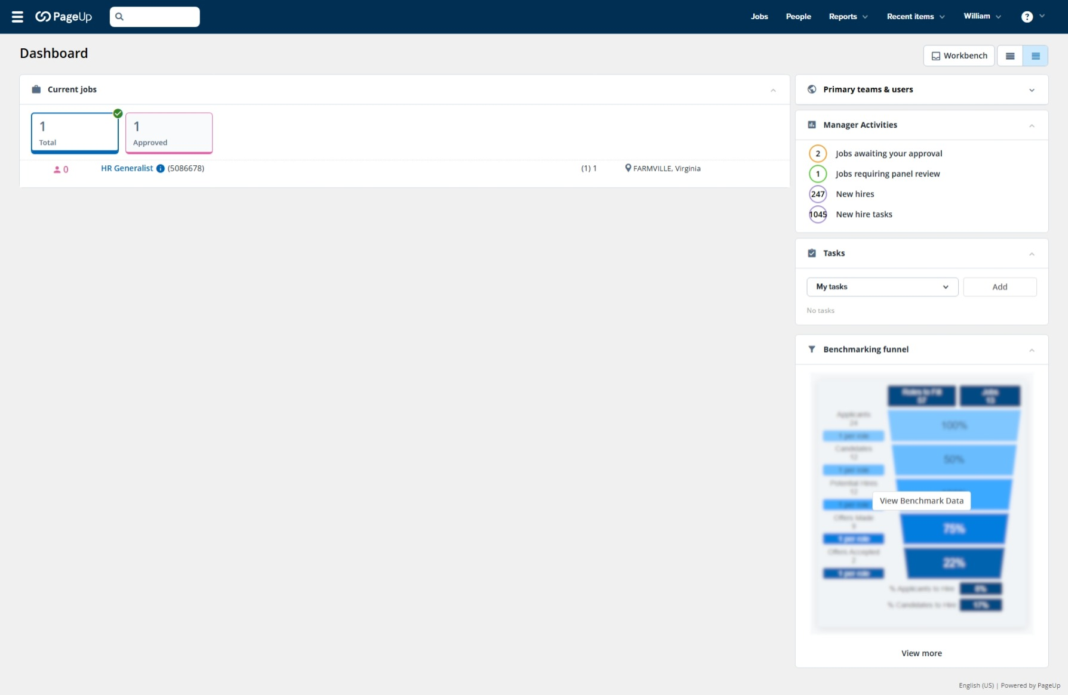
Checking for a Position Description
This is the landing page for the position descriptions. Click on the three horizontal lines on the top left of the page and a drop down will appear. Go to next slide.

Slide 6
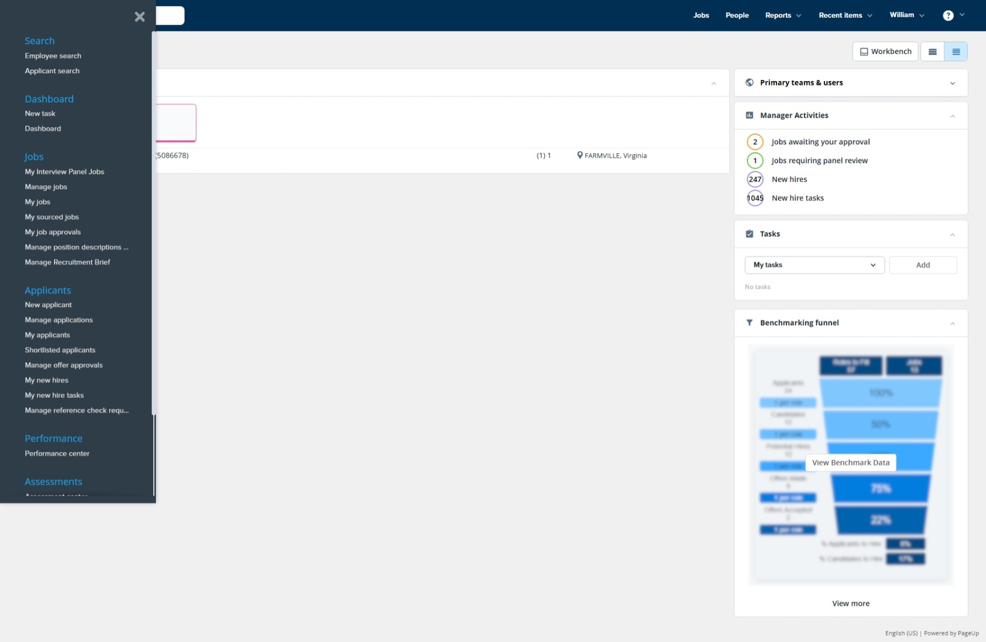
Position Description Drop Down List
When the drop down appears, click on the link for “Manage Position Descriptions” which is under the “Jobs” tab. Go to next slide.

Slide 7
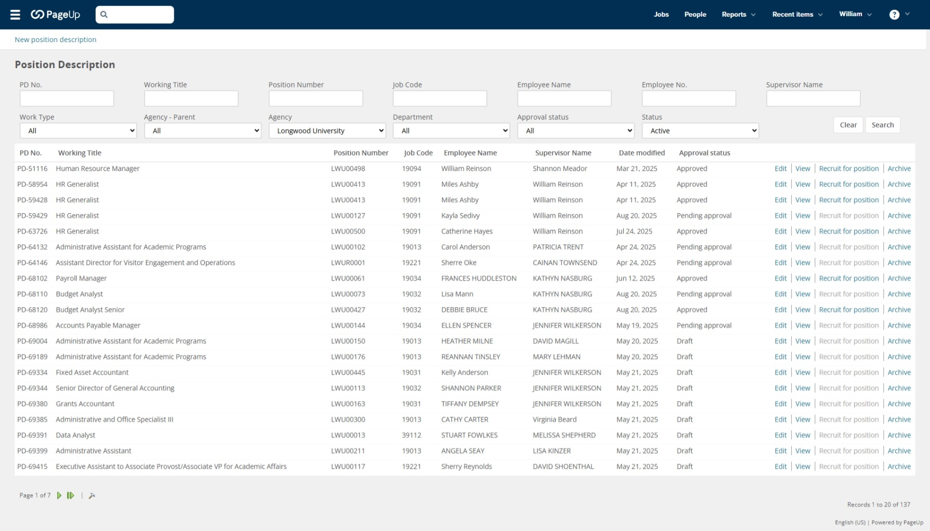
Position Description Page
You will be directed to this page and need to fill in three boxes with the information in the parentheses. The “Agency” (Longwood), “Status” (Active), and “Position Number” (From the EWP) in the following five-digit format (LWUXXXXX), example LWU00799. After entering, press “Search.” Go to next slide.

Slide 8
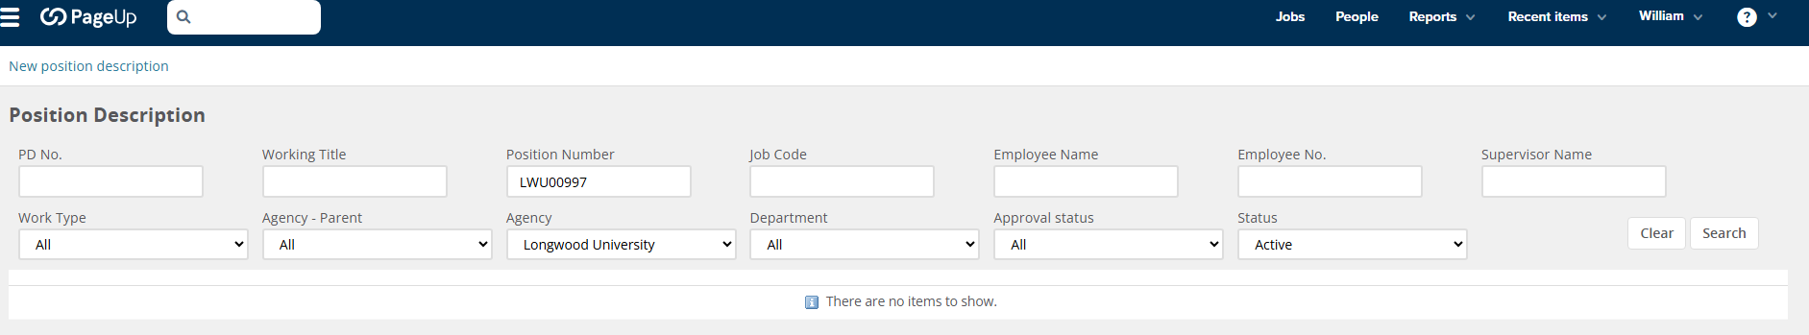
No Position Description Found
If you receive this result, with the phrase “There are no items to show,” your Position Description will need to be entered. Click on the “New Position Description” near the upper left hand corner. Go to the next slide.

Slide 9
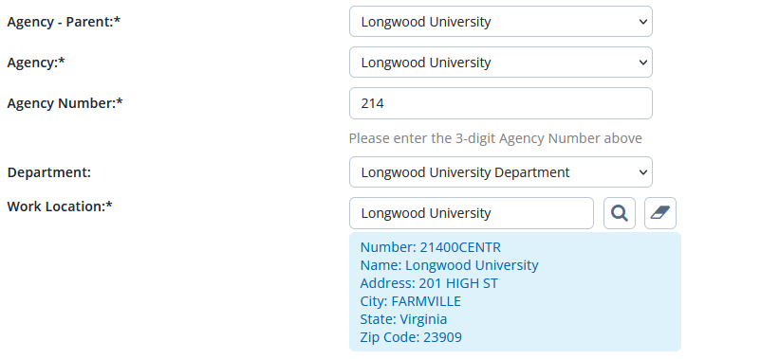
Information to Enter in the Position Description
Job Title & Code = Role Code number on previous EWP.
Most of the information for the PD will be from the EWP. Some will self-populate. Refer to this page for the remainder. Go to the next slide.

Slide 10
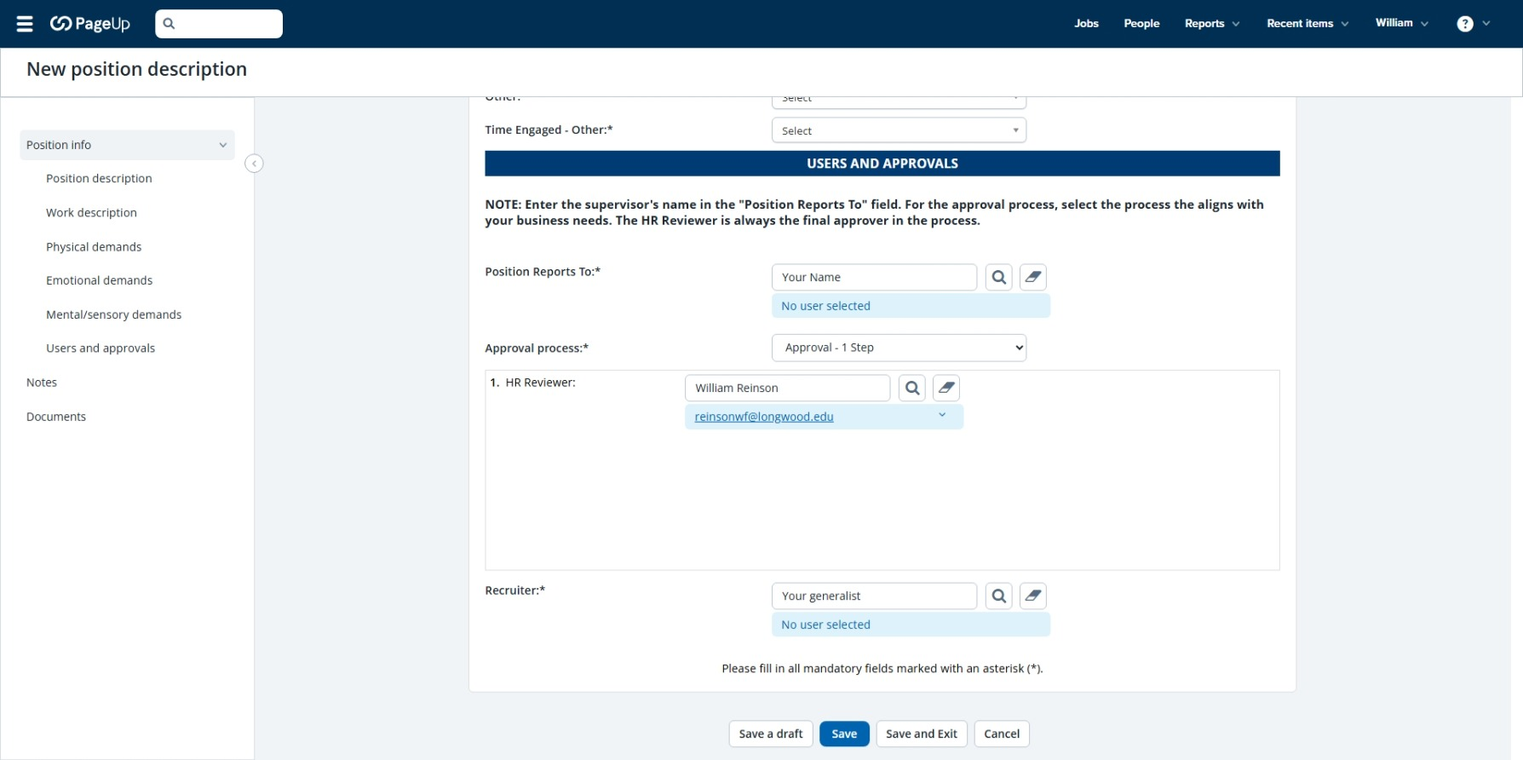
Note on Creating a Position Description
NOTE: If you need to stop during the process and return to complete it later, click on the “Save a Draft” box and exit the program. When you return, start back at slide #1 (sign in) of this slide show. When you arrive at slide #7, your PD should show as “Draft.” Open it by clicking the “edit” button and you can complete the PD. Prior to hitting the “Save” or Save and Exit” buttons, go to the next slide.

Slide 11
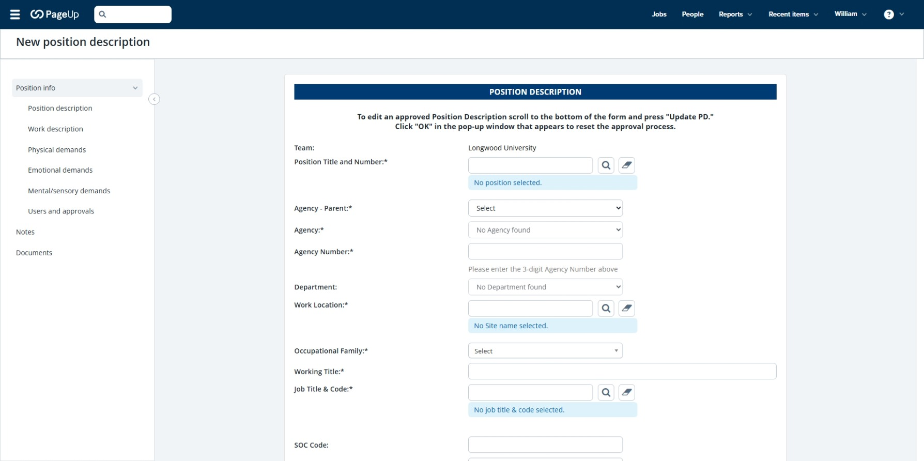
Creating a Position Description – Page 1
Begin entering information:
Enter the Position Title (in the format LWU00XXX) and click on the magnifying glass. This field will self populate.
From the previous page (Agency- Parent, Agency, Agency Number, Department and Work Location)
From the EWP (Occupational Family, Working Title, Job Title and Code, SOC Code)
Once this information is entered go to the next slide.

Slide 12
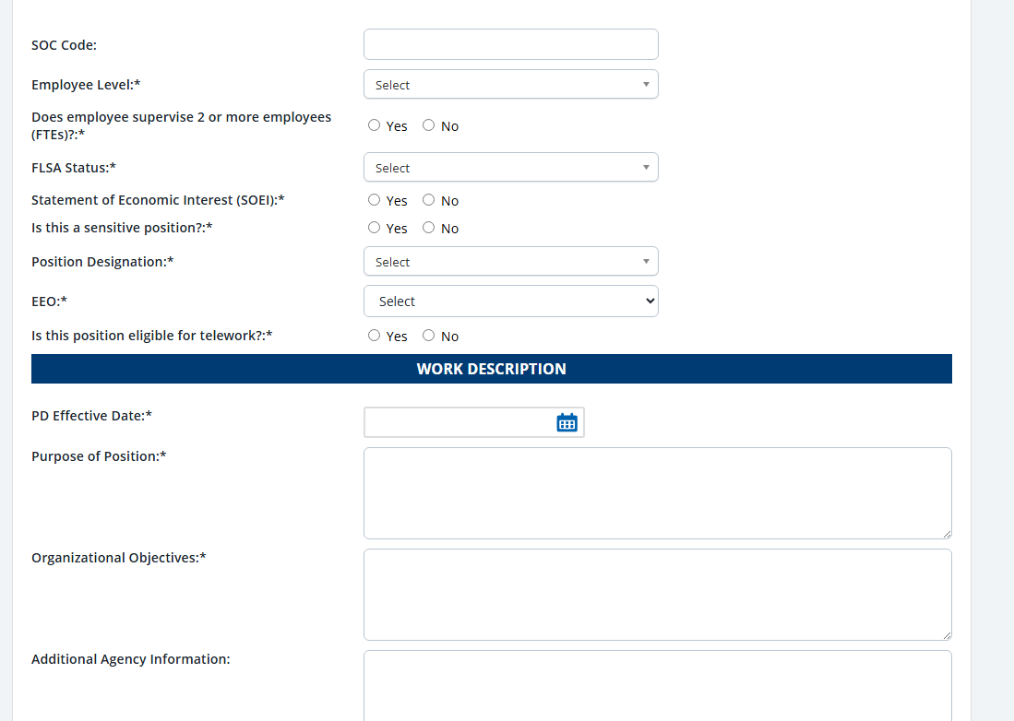
Creating a Position Description – Page 2
For the PD effective date, enter today’s date. All other information should be found on the EWP. Enter info and go to the next slide.

Slide 13
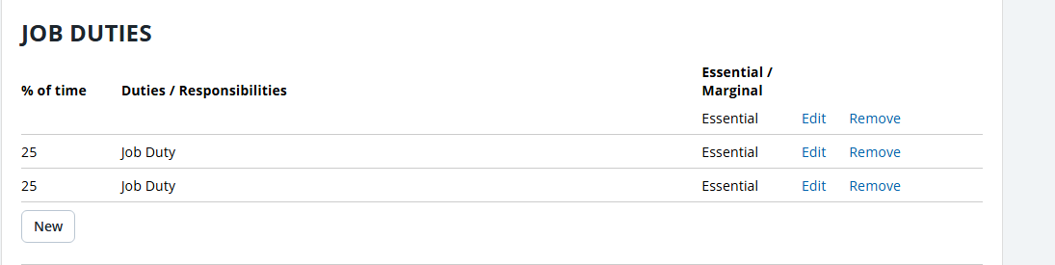
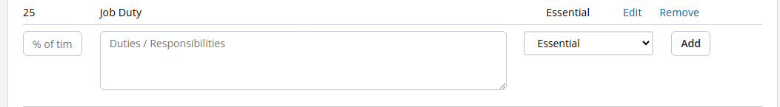
Creating a Position Description – Page 3
This information should be on the EWP. Enter as many job duties as necessary (must total 100%). The first box displays the “New” button. Hit the new button for each new duty. The second box shows what it will look like once opened. Enter the % of time in the first box (total for all percentages must be 100%) In the Job Duty box, you can either type the duties/responsibilities or cut and paste them from a Word Document. Enter as much information as necessary. Make sure to note whether the duty is “Essential” or “Marginal” by using the drop down to the right. Once a job duty is complete, hit “Add” to move to the next duty. Once complete, go to the next slide.

Slide 14
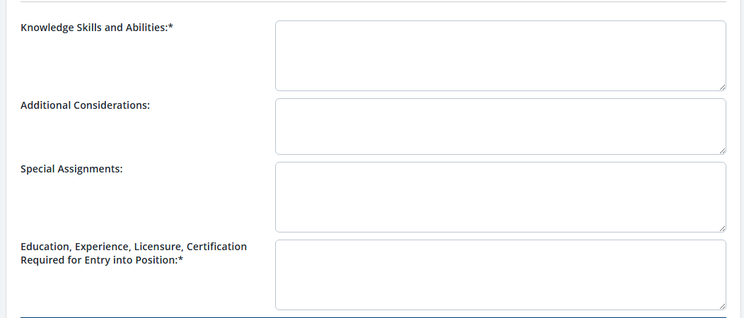
Creating a Position Description – Page 4
Enter the KSA, Additional Consideration, Special Assignments and Education, Experience, etc.
These should be available on the EWP. Once complete, go to the next slide.

Slide 15
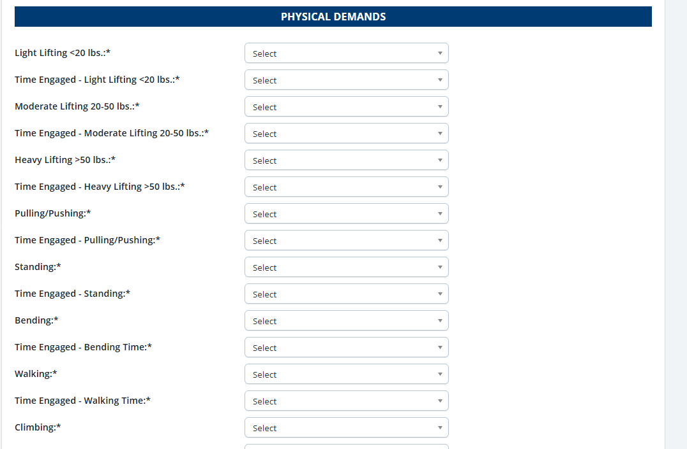
Creating a Position Description – Page 5
Click on each drop-down in the “Physical Demands” section and select the response that applies. You will need to provide a response for every box or the PD will not save. Once the “Physical Demands” are complete, go to the next slide.

Slide 16
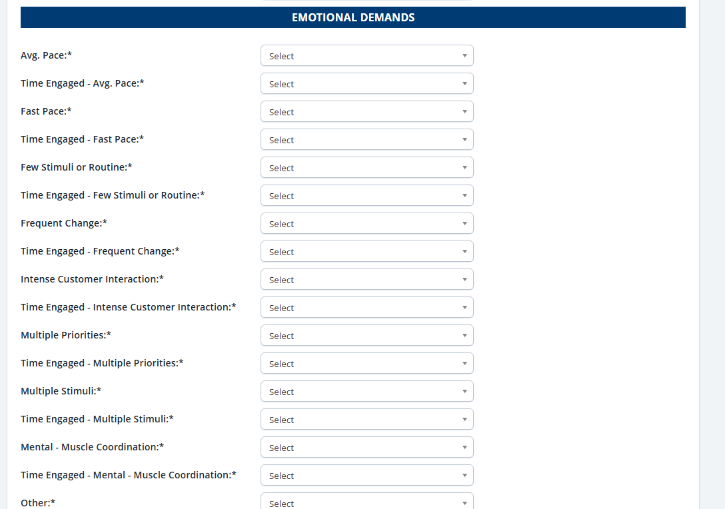
Creating a Position Description – Page 6
Click on each drop-down in the “Emotional Demands” section and select the response that applies. You will need to provide a response for every box or the PD will not save. Once the “Emotional Demands” are complete, go to the next slide.

Slide 17
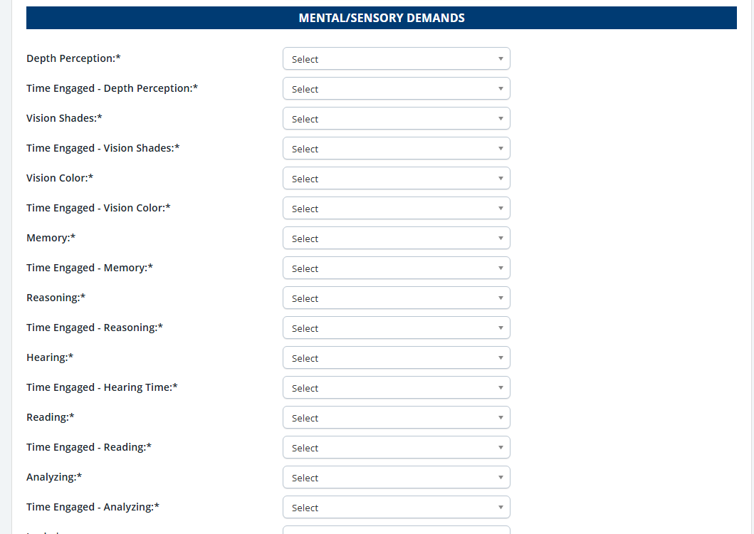
Creating a Position Description – Page 7
Click on each drop-down in the “Mental/Sensory Demands” section and select the response that applies. You will need to provide a response for every box or the PD will not save. Once the “Mental/Sensory Demands” are complete, go to the next slide.

Slide 18
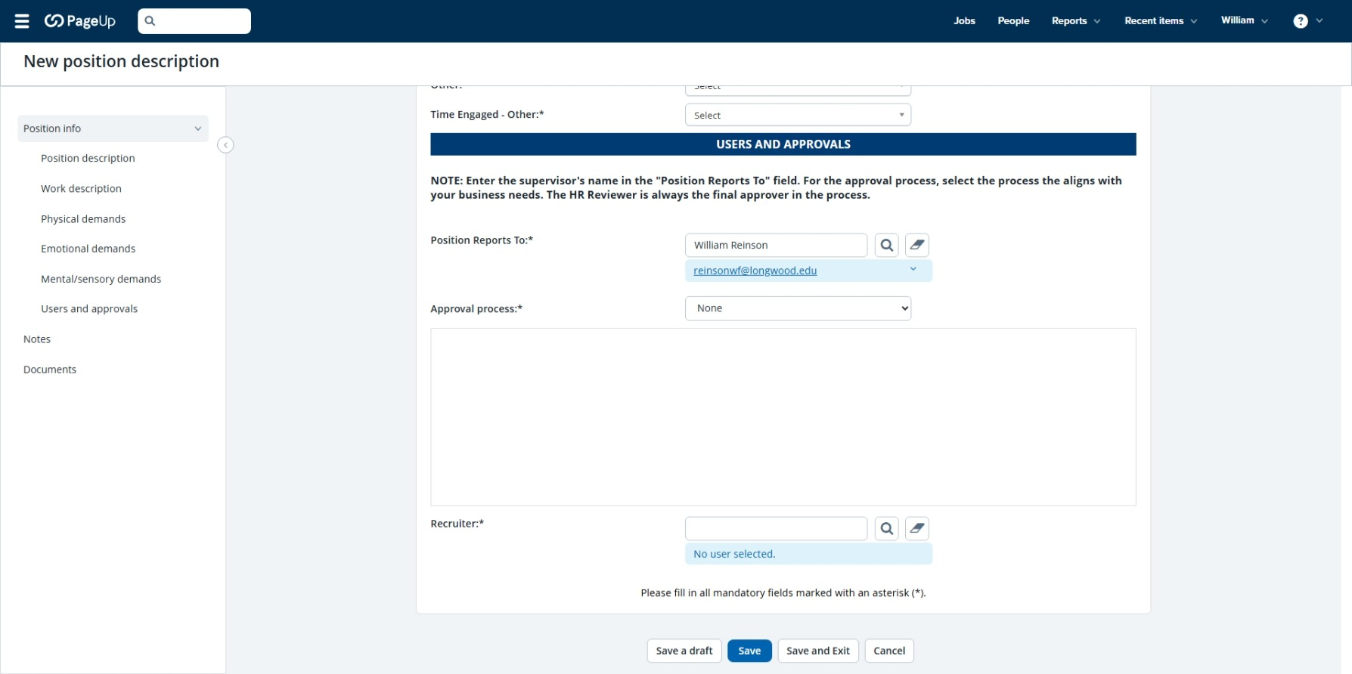
Creating a Position Description – Page 8
This is what the Users and Approvals Section looks like. It is located at the bottom of the page. Once you have entered everything on the PD, you will end up here. Go to the next slide for approval instructions.

Slide 19
Creating a Position Description – Page 9
Under “Position Reports To” enter your/the manager’s name and click the magnifying glass. The name should appear. Under “Approval Process” click “Approval – 3 Step.” Under HR Reviewer, enter “Lisa Mooney” and hit the magnifying glass. The name should appear. Under “Recruiter,” enter the name of your assigned recruiter and hit the magnifying glass. The name should appear. If you are uncertain of your recruiter, just list “Catherine Hayes” and we will correct it. Once completed, go to the next slide.

Slide 20
Creating a Position Description – Page 10
Once the PD is complete, you will click the “Save” or “Save and Exit” button. This will forward the PD to the appropriate parties for approval. Once the PD is approved, you will receive an email (next slide) informing you that you can proceed with the Employee Performance Profile (EPP). Click “Save” or “Save and Exit” and go to the next slide.

Slide 21
Creating a Position Description – Page 11
From: PageUp PD Approval <jobapproval.mkbphkm.qqlm.hvhvhm@m.dc4.pageuppeople.com>
Sent: Friday, April 11, 2025 7:54 AM
To: “Manager”
Subject: Position Description Approval
CAUTION: This is an EXTERNAL email. Do not click links or open attachments unless you recognize the sender and know the content is safe.
Hi “Manager’s Name,”
The position description HR Generalist - Position description number: 59429 has been Approved. To view the position description, click the following link: View Position Description.
Note: Non-COV network users please log in HERE and navigate to the Position Description library.
Kind regards,
Longwood University Recruitment Team
This is an example of the email you will receive when your PD has been approved. Once you receive it, you will be able to move to the next step of the EPP process. You will be receiving another slide show with instructions to guide you through the EPP process.

