Slide 1
Steps to advertise a vacant position in Hirezon
Copy and paste link below and hit enter
https://www.interviewexchange.com/login.jsp

Slide 2
Enter your email and it will automatically redirect to a Longwood screen

Slide 3
Enter your LancerNet ID and Password Click Login

Slide 4
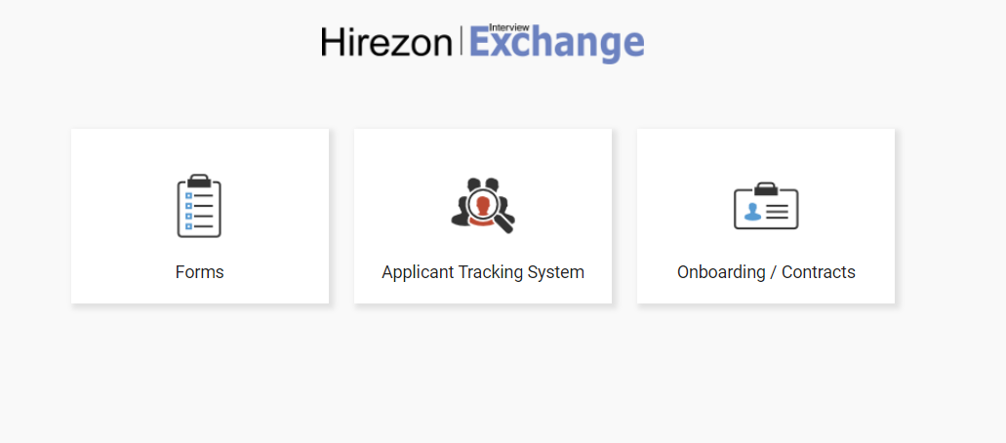
Click on Forms

Slide 5
Click on Start New Form

Slide 6
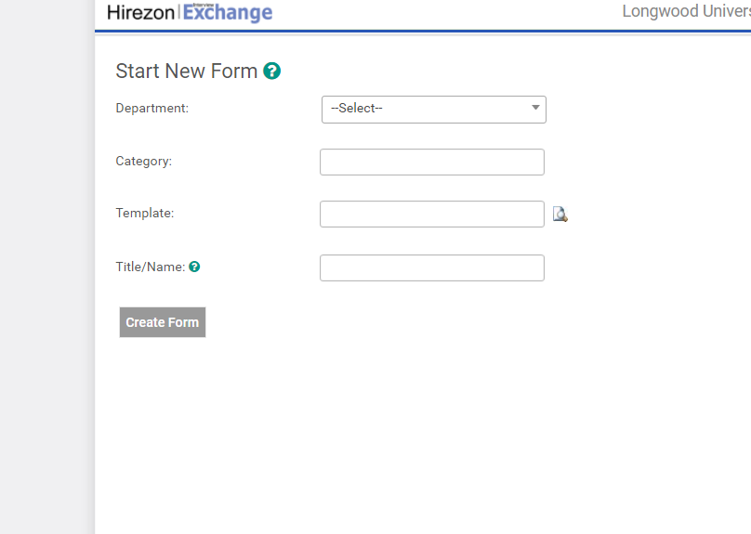
Steps to complete Recruitment Request
Select the appropriate department and click ok
Select Category – Recruitment
Select Template – Recruitment Request/Hiring Report
Enter the job title
Click on Create Form

Slide 7
Example of screen after clicking create form

Slide 8
Click on Recruitment Request – not on box

Slide 9
Recruitment Request form

Slide 10
Recruitment Request
Fill out all sections of Recruitment Request
Please select 1 option (there are 4 choices) – vacancy, new position, seasonal/temporary, or no recruitment
Department – Prepopulated
Title – Prepopulated
Proposed salary
Position #
Please suggest Advertisement sources that you would like to post the job
Please indicate the number of positions to be filled (if multiple)
Advertising Budget Code
Do you want to advertise externally? Yes or No
Type of Search – General Public, All State Employees or Longwood Employees only
Salary Budget Code
If filling a vacant position, indicate first and last name of individual being replaced
Separation Date of individual being replaced

Slide 11
Fill out all sections of Recruitment Request
Position Type – Select one of the options
Instructional Faculty
Administrative/Professional
Classified
Adjunct Faculty
Miscellaneous (PT A/P)
Classified Restricted
Funded Wage
Temporary Wage

Slide 12
Fill out all sections of Recruitment Request
Hours/Week
Position Schedule: (ex. M-F, 8:00 am – 5:00 pm)
Name of Person’s Supervisor
Person Making Hiring Decision
Extension
Proposed List of Search Committee Members:
Search Committee Name
Search Committee Email

Slide 13
Click on Save & Submit

Slide 14
Click on Edit for changes or Continue

Slide 15
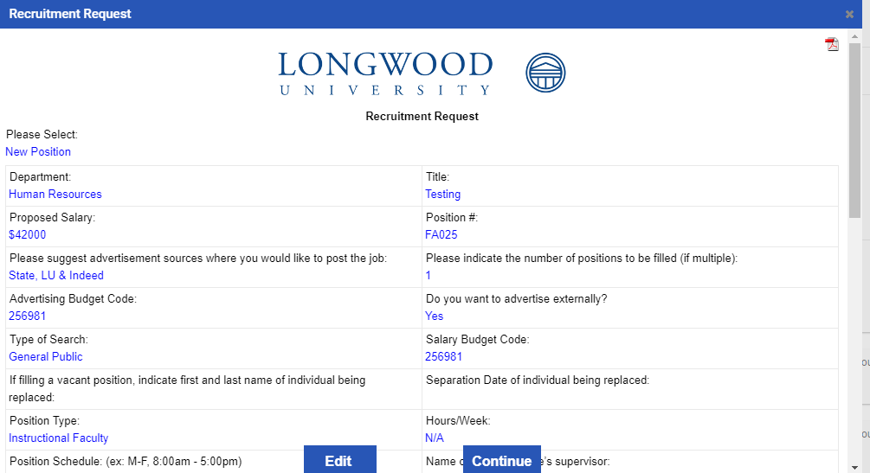
Example of Recruitment Request Form

Slide 16
Example of Recruitment Request Form

Slide 17
After clicking continue returns to the main screen

Slide 18
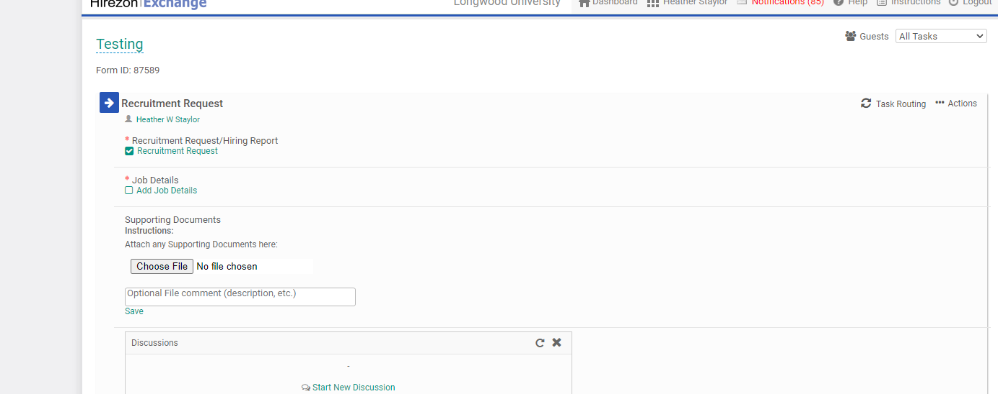
Click on Task Routing

Slide 19
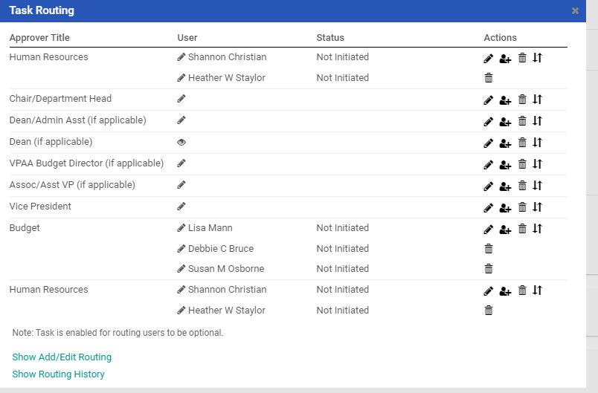
Click on each applicable approver step and enter appropriate name/email. You should have multiple approvers. Human Resources and Budget are prepopulated

Slide 20
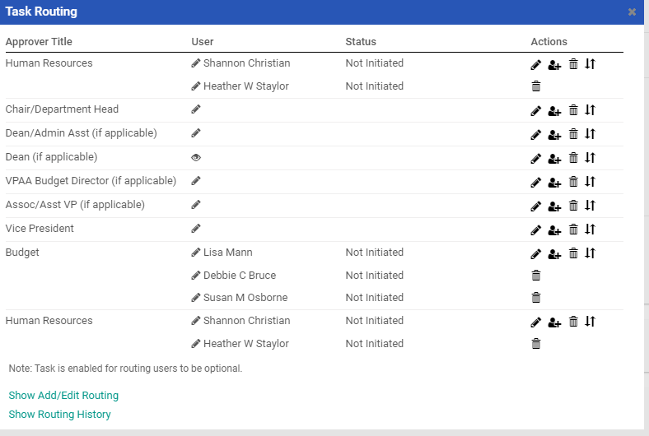
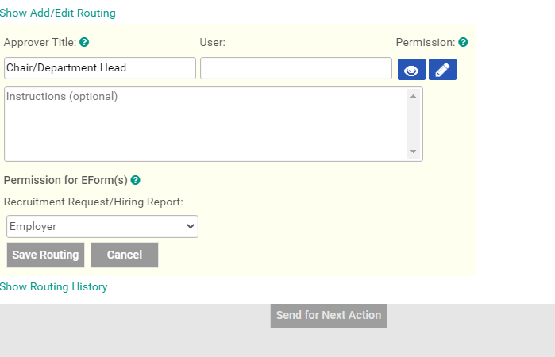
Click on the pencil icon. Add the user and instructions if applicable
Type user name in box and click on save routing

Slide 21
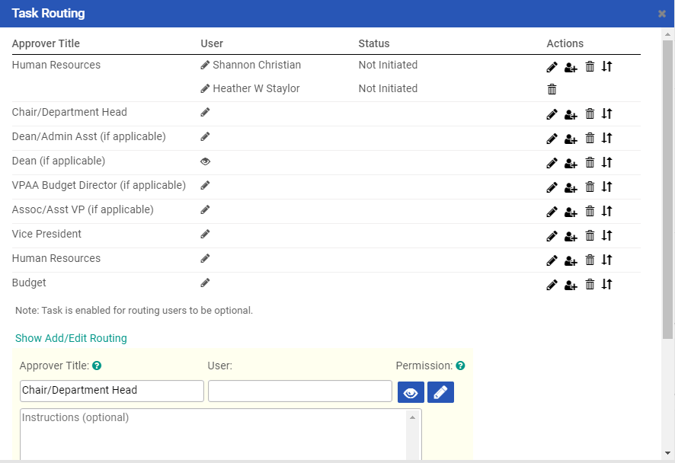
Repeat steps for adding applicable approvers in the task routing process
Click on pencil icon for applicable approver. Type name (first or last name) in user box and it will prepopulate, click on name of approver. Save routing after adding each applicable approver

Slide 22
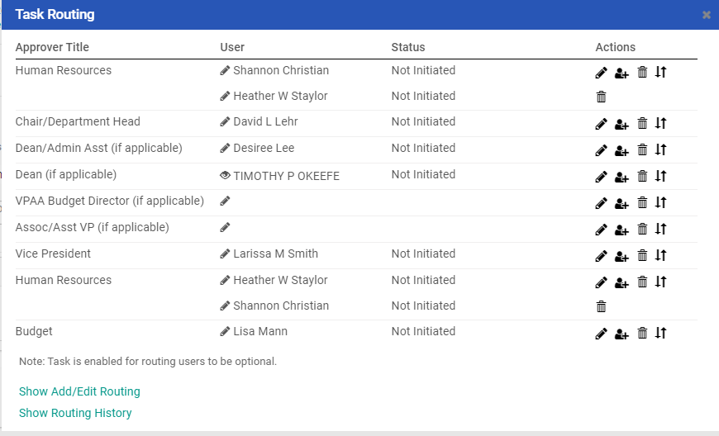
Example of Task Routing with Approvers

Slide 23
After adding all applicable approvers. Click on x to close box
After clicking on save routing, click on x to close box

Slide 24
Click on add job details

Slide 25
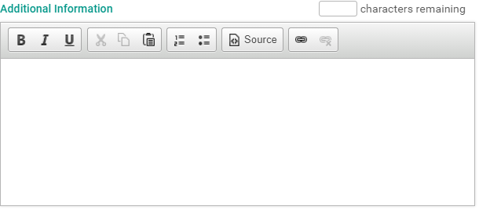
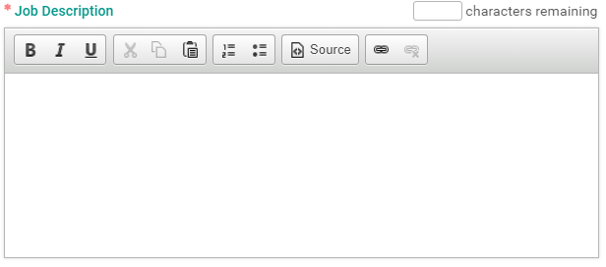
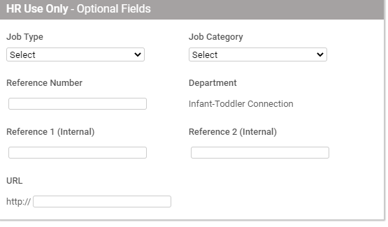
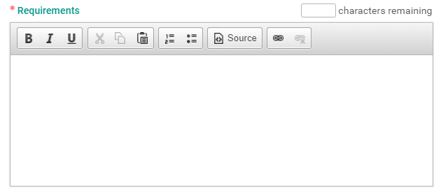
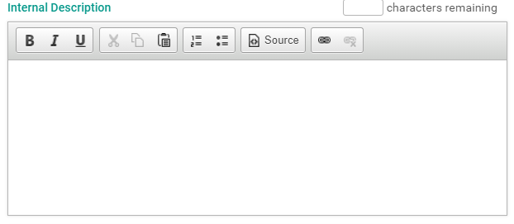
Add Job Details and after completed Save Job Details.
HR will fill out this section

Slide 26
Click on Save Job Details

Slide 27
Click Edit to make changes or Close

Slide 28
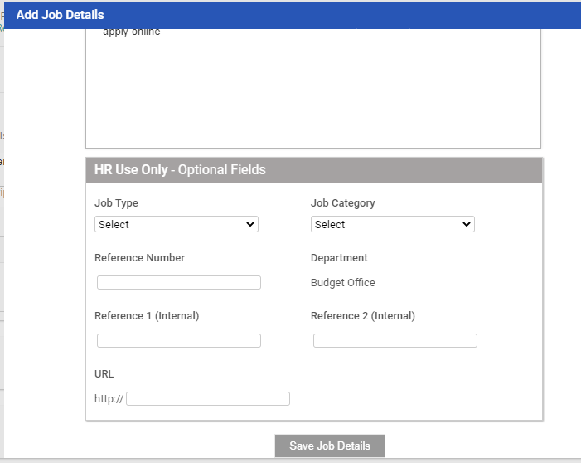
Click on Edit, brings you back to Add Job Details to make changes. After changes are made, scroll down and save job details

Slide 29
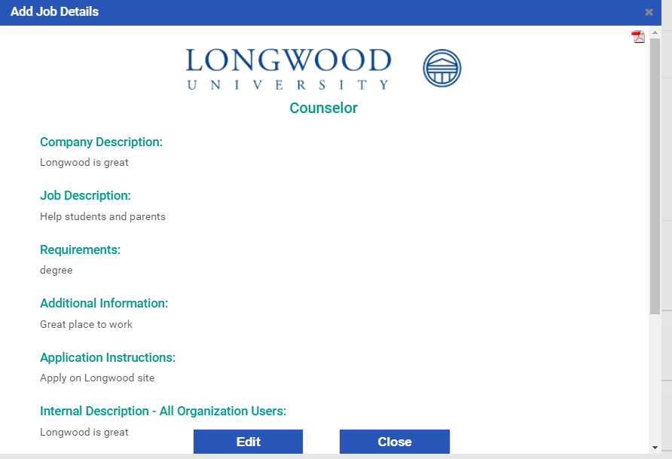
Click on Close, returns to main screen to proceed
Main Screen

Slide 30
Attach Supporting Documents. Click on choose file and upload documents. Examples – EWP, position description, advertising worksheet, etc.

Slide 31
Look for the file that will need to be uploaded
Example of the screen when uploading a file for supporting documents

Slide 32
Example of supporting documents attached

Slide 33
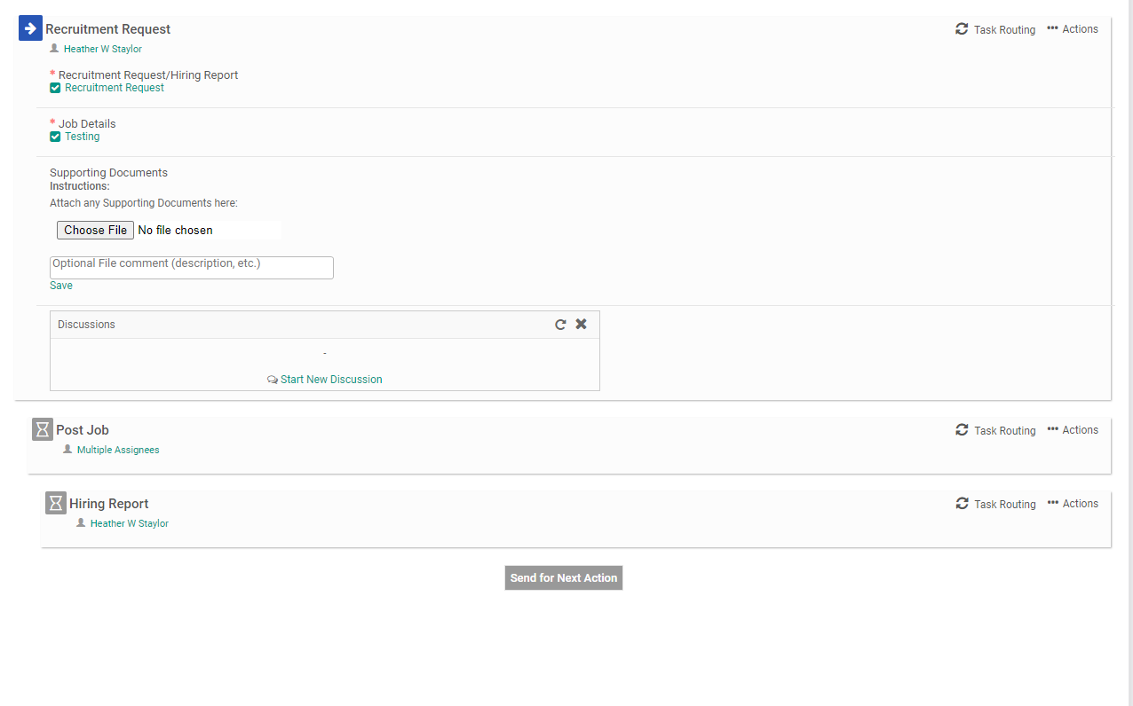
Hiring Report task routing should be completed before clicking on Send for Next Action. Add approvers for Hiring Report for Task Routing

Slide 34
Task Routing for Hiring Report (Human Resources and Budget are pre-populated). Add other approvers that need to be added

Slide 35
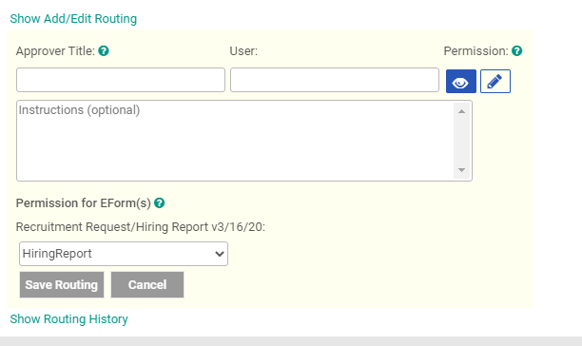
Click on each applicable approver step and enter appropriate name/email. You should have multiple approvers. Human Resources and Budget are prepopulated. Click on pencil icon to show approver title, type name in user to add approver. After adding each user, scroll down and click on save routing
Click on pencil icon to bring up approver title, type name in user to add approver and click on saving routing. Repeat each step for each user

Slide 36
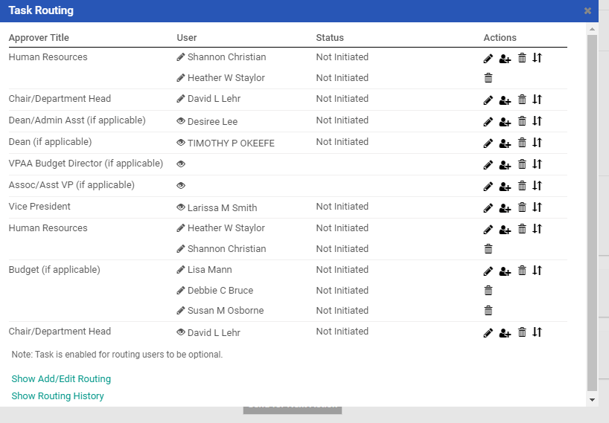
The task routing will be sent by email in the approval process for each selected person for approval or changes.

Slide 37
After adding all applicable users, click on x to close box

Slide 38
Example of Task Routing on whom it will be sent to

Slide 39
Recruitment Request and Job Details should have a check in the box as completed

Slide 40
Click on Send for Next Action

Slide 41
After clicking on send for next action status will change from not initiated to In Progress

Slide 42
Example of the email from Hirezon for Task Review

Slide 43
Task Approvers After receiving the email from Hirezon/Interview Exchange, login to Hirezon to view Recruitment Request. Enter your email and it will automatically redirect to a Longwood screen

Slide 44
Task Approvers Enter your LancerNet ID and Password

Slide 45
Task Approvers Click on Forms

Slide 46
Task Approvers After clicking on Forms, your dashboard will come up

Slide 47
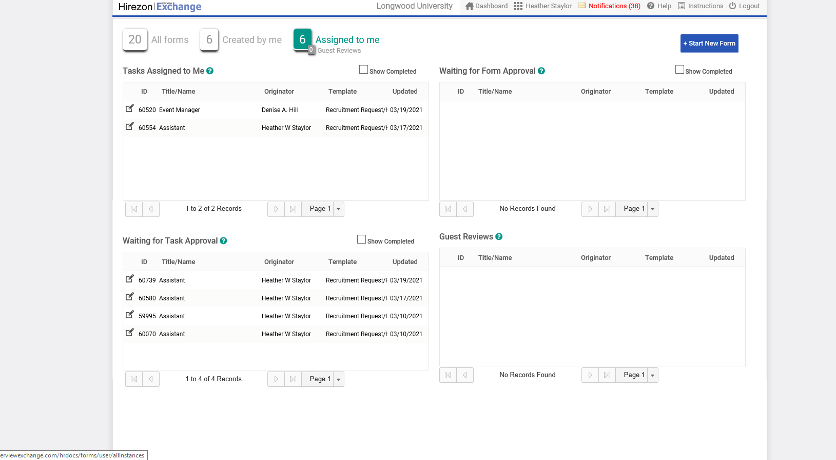
Task Approvers Click on Assigned to me. Task will either be in Tasks Assigned to Me or Waiting for Task Approval

Slide 48
Task Approvers Click on pencil on paper icon on the task that is assigned

Slide 49
Click on Review Task

Slide 50
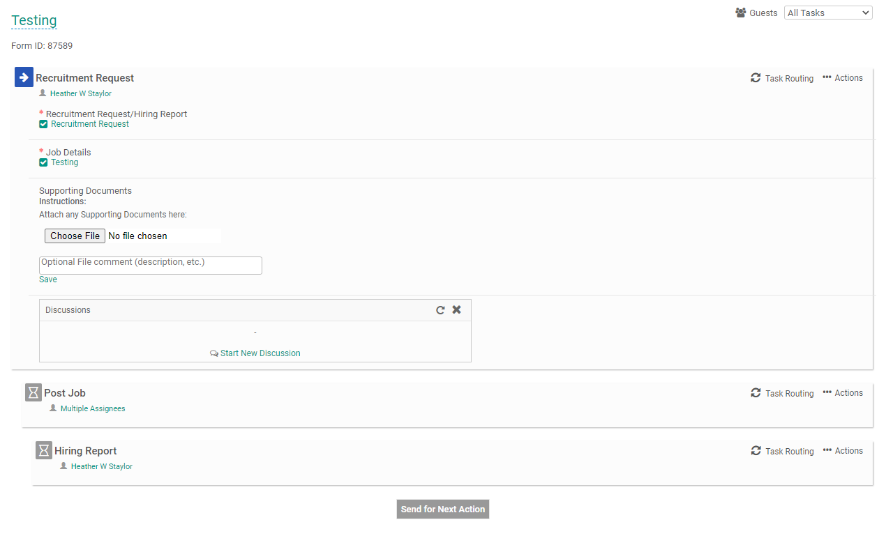
Task Approvers Click on Recruitment Request

Slide 51
Task Approvers Click save & submit

Slide 52
Task Approvers Click on edit if changes need to be made or continue if there are no changes.

Slide 53
Task Approvers Click on position title under Job Details to review vacancy announcement.

Slide 54
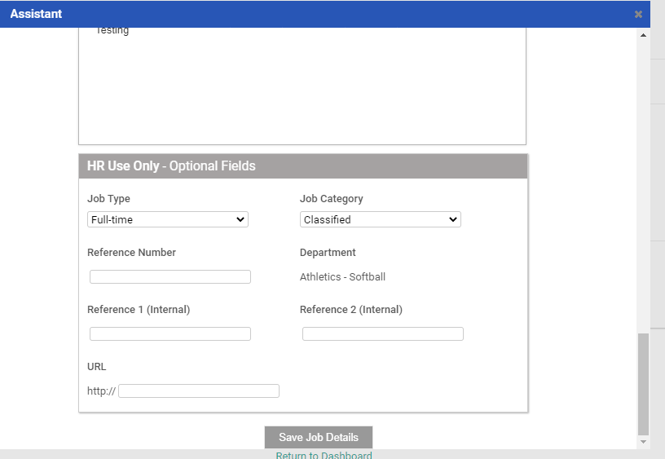
Task Approvers Scroll down to click on Save Job Details

Slide 55
Task Approvers Click on Edit to make any changes or close

Slide 56
Task Approvers Recruitment Request and Job Details have a check mark in the box

Slide 57
Task Approvals Click on Approve

Slide 58
Task approved successfully

Slide 59
If click on deny, complete this process

Slide 60
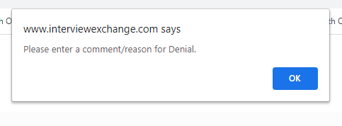
If clicked on Deny, Please enter a comment/reason for denial
After clicking deny, click ok
Insert comment on why it was denied

Slide 61
Task was Denied

Slide 62
Approver denied task during Recruitment Request review. Login to your account to review and make changes. The originator will receive an email, example below.

Slide 63
Instructions after approver denied Recruitment Request

Slide 64
After receiving the email from Hirezon/Interview Exchange, login to Hirezon to view Recruitment Request. Enter your email and it will automatically redirect to a Longwood screen

Slide 65
Enter your LancerNet ID and Password

Slide 66
Click on Forms

Slide 67
Click on Recruitment Request

Slide 68
Click on Actions

Slide 69
Mark As Incomplete

Slide 70
Click on ok

Slide 71
Click on Actions

Slide 72
Click on republish

Slide 73
Click ok

Slide 74
Click on Recruitment Request

Slide 75
Click on edit to make necessary changes to Recruitment Request

Slide 76
Once changes are made, click on Save & Submit

Slide 77
Click on edit if anymore changes or continue

Slide 78
Click on Send for Next Action

Slide 79
Task completed, sent to approver(s)

Slide 80
Email sent to approver(s) for approval of recruitment request

Slide 81
Example of email for Task Approver

Slide 82
Once the task has been completed that was assigned to you, it will move onto the next phrase of the process

Slide 83
Example of the email approver will receive

Slide 84
If the task was approved it will continue in the approval process and an email will be sent to the next approver

Slide 85
After all approvals received, job will be posted by Human Resources. After an appropriate selection process, a hiring report will need to be completed

Slide 86
Success! Job completed!

