Slide 1
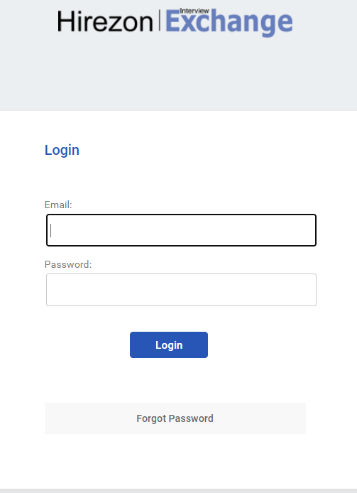
Completing the Hiring Report
Enter your email and it will automatically redirect to a Longwood screen

Slide 2

Enter your LancerNet ID and Password

Slide 3
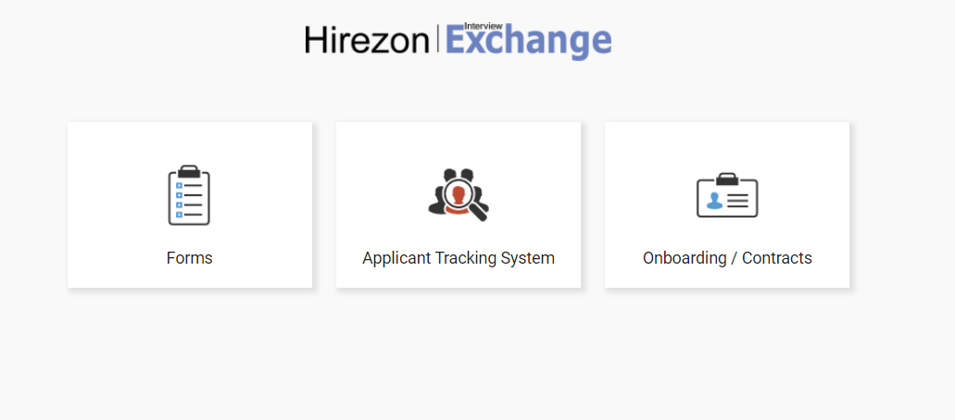
Click on Forms

Slide 4
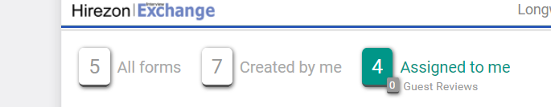
Click on Assigned to me

Slide 5
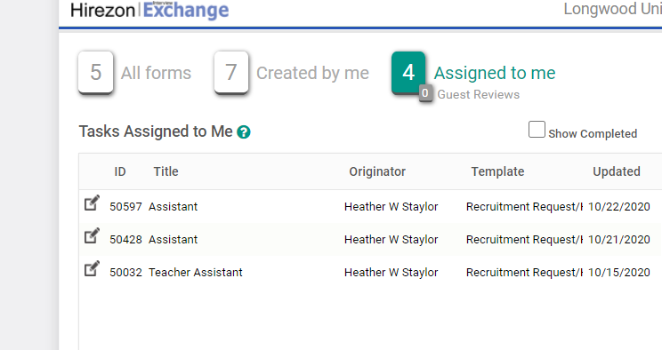
Click on pencil on paper icon

Slide 6
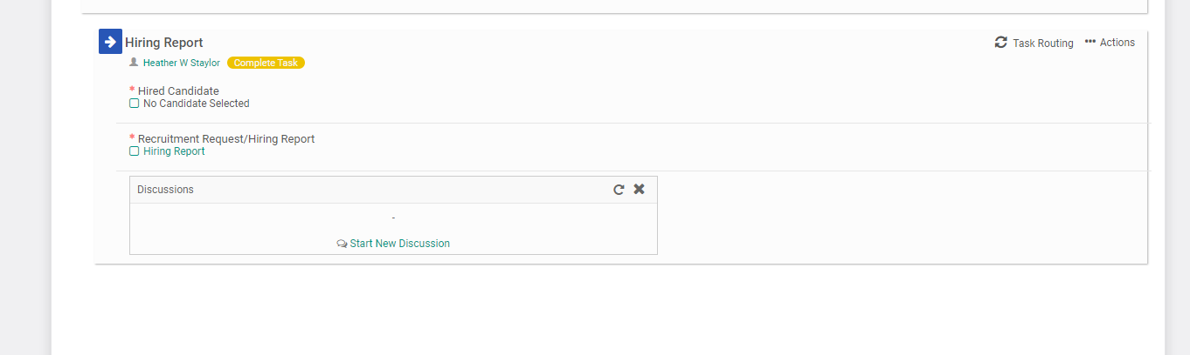
Click on Complete Task

Slide 7
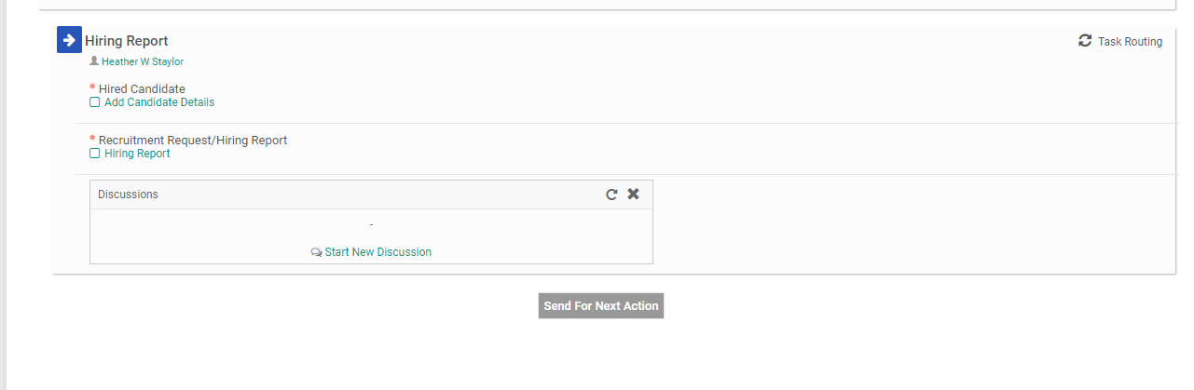
Click on add candidate details

Slide 8
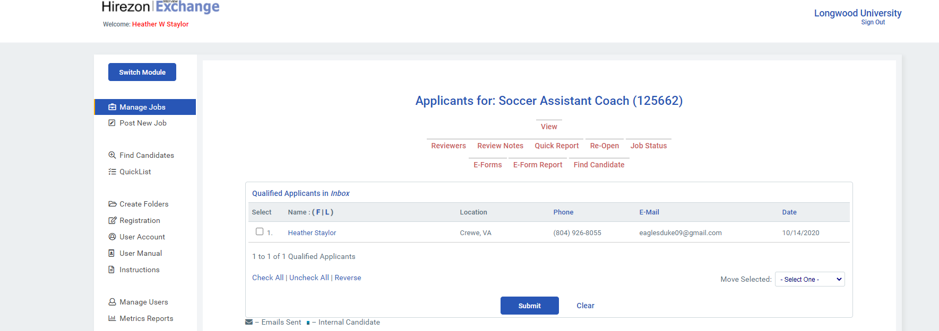
Click on Find Candidate.

Slide 9
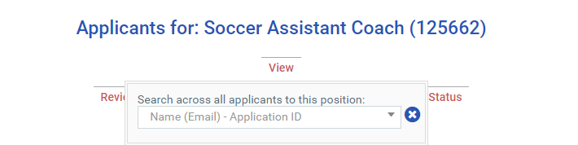
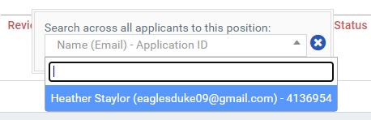
After clicking on find candidate box below appears. Click on arrow and find candidate you want to hire and click on candidate’s name.

Slide 10
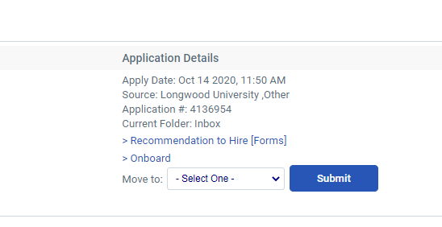
Click on Recommendation to Hire (Forms)

Slide 11
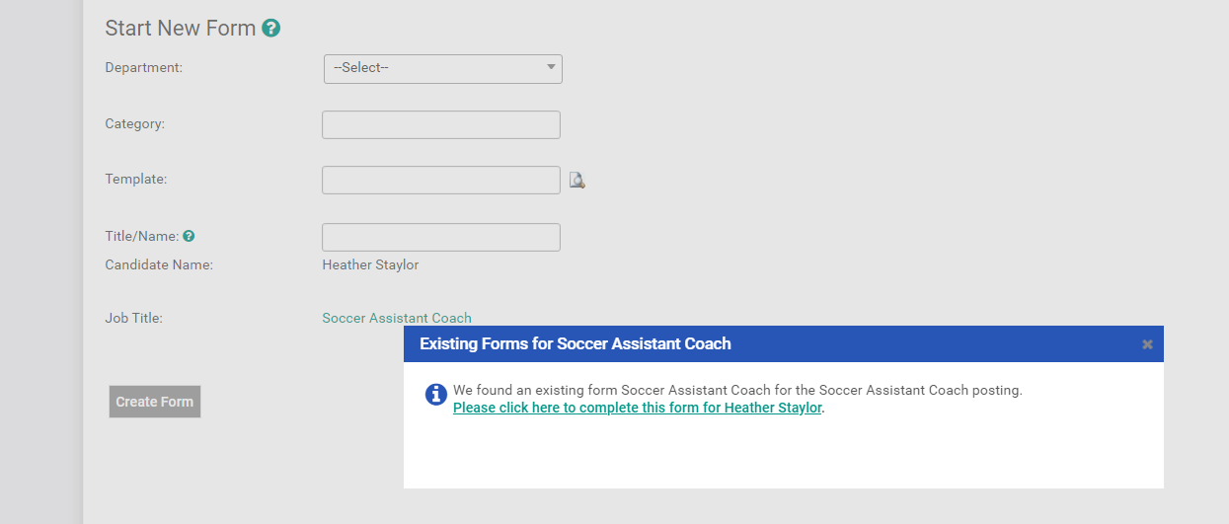
Click on here to complete this form for candidate.

Slide 12
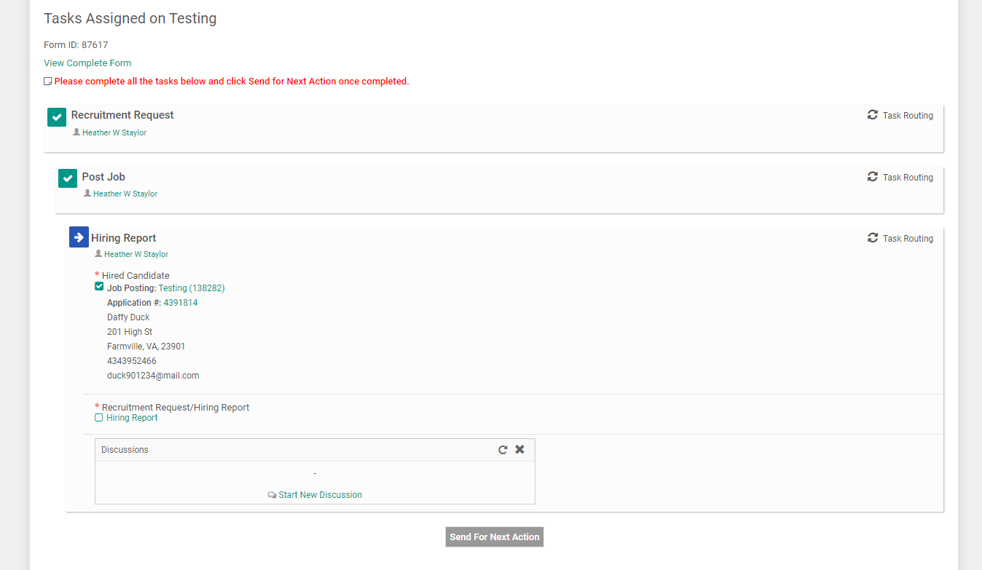
Information for the candidate is prepopulated. Click on Hiring Report

Slide 13
Completing the Hiring Report – All fields must be filled in.
Recommended Candidate Name – will be populated from previous steps
Position Number
Salary
Start Date
End Date (if applicable)
Full Job Title
Department – will be populated from previous steps
Office Building
Office Room Number
Office Phone Number
Budget Code
Name of person’s supervisor
Will the candidate supervise others? Yes or No
If yes, provide names

Slide 14
Completing the Hiring Report
Moving/Relocation
Tenure Status – select one (if applicable)
  Tenured
  Tenure Track
  Non-Tenure Track
If Tenure Track please specify year of review
Length of Contract (if outside a normal one year contract)
Additional Terms/Special Considerations

Slide 15
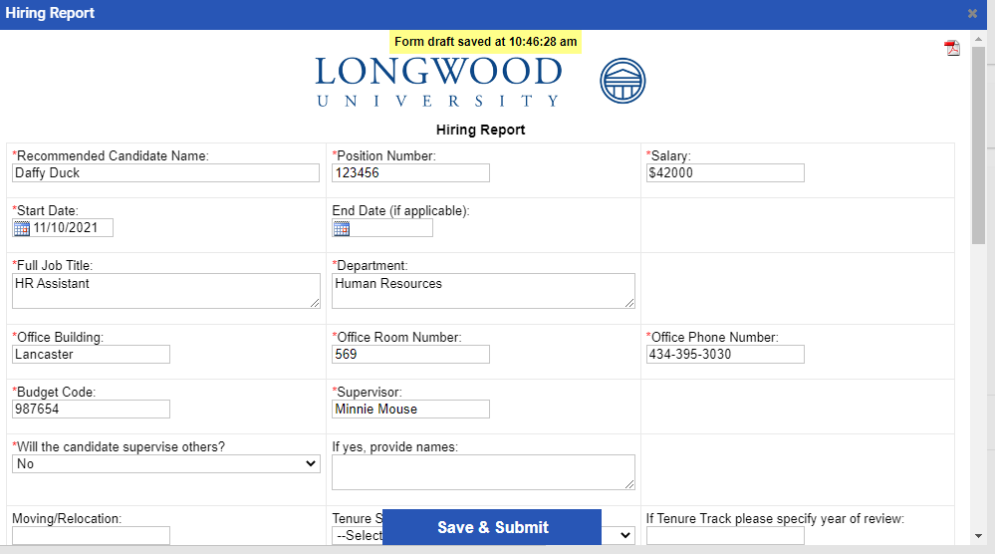

Example of Hiring Report

Slide 16
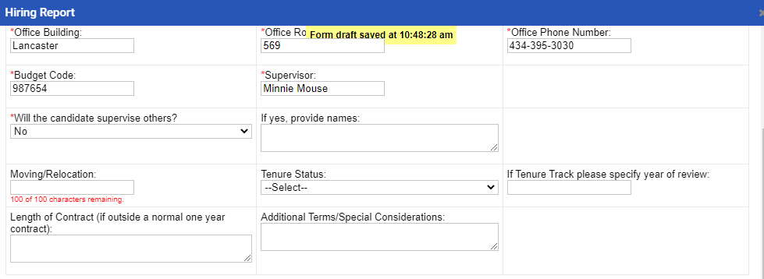
Example of Hiring Report

Slide 17
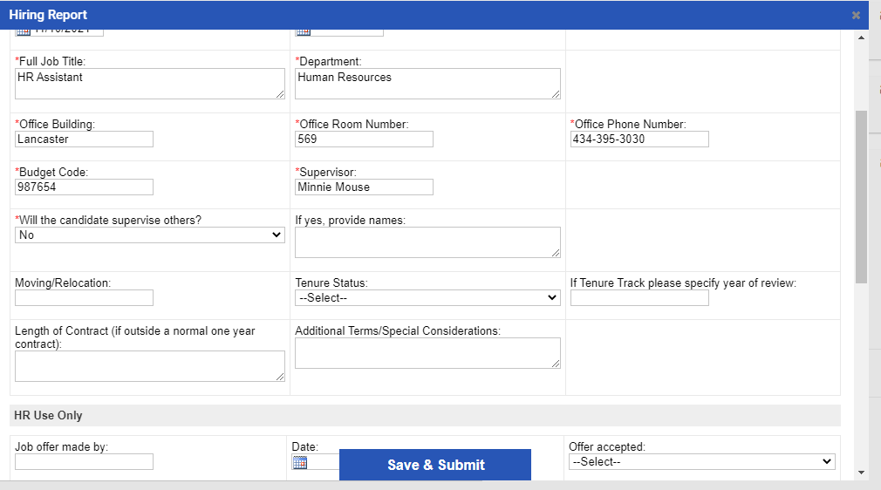
Click on Save & Submit

Slide 18
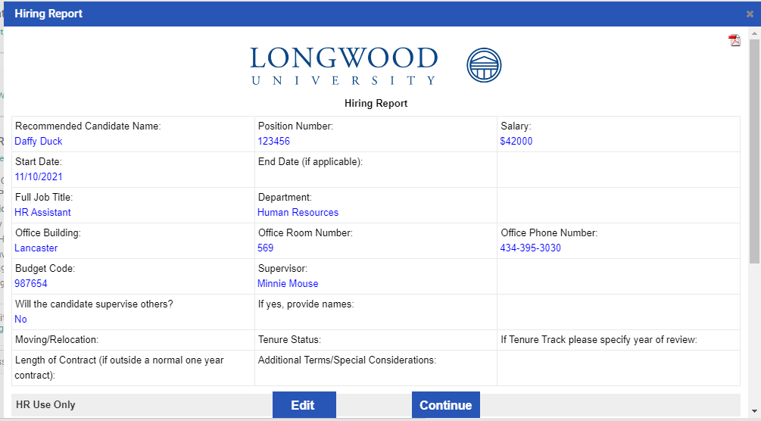
Click Edit (to make any changes) or Continue

Slide 19
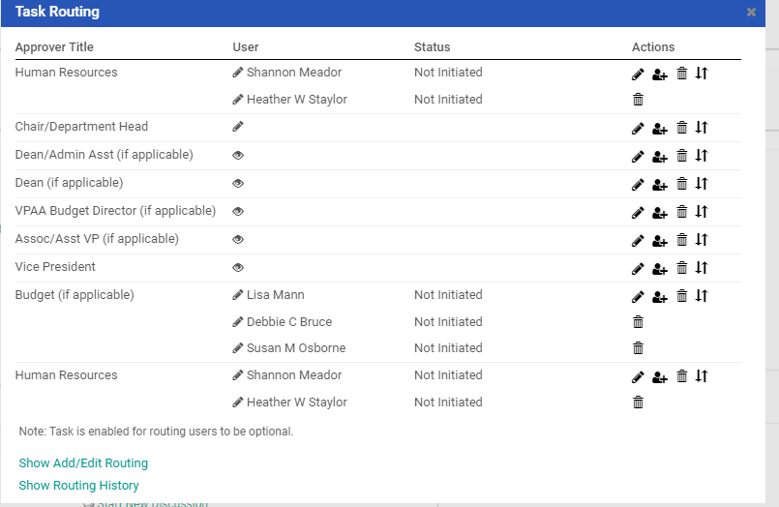
Can add approvers for Task Routing if didn’t add all approvers during first steps for completing during the recruitment request. Click on pencil icon and add user. Click on save routing.

Slide 20
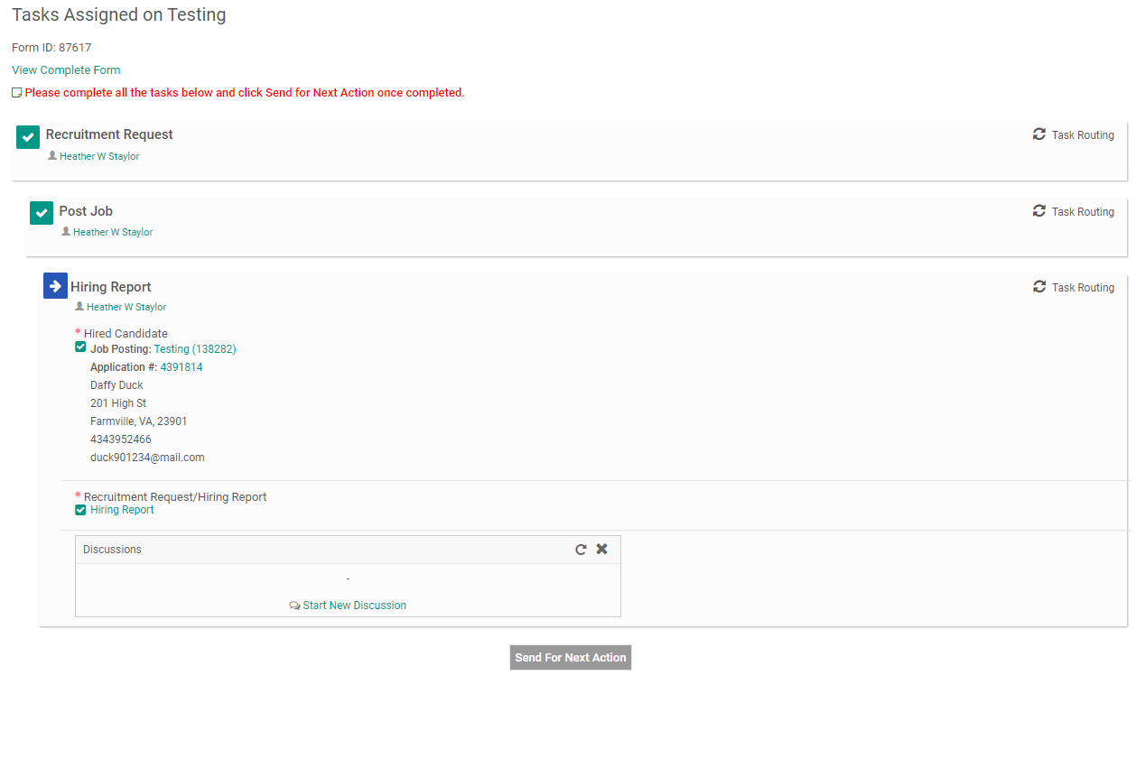
Hiring Report completed. Click on send for next action

Slide 21
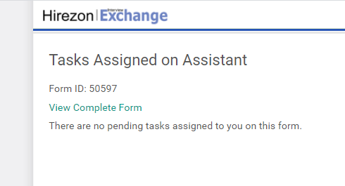
Hiring Form completed

Slide 22


Success! Hiring Report completed!

