Slide 1
Initial Login Instructions
PageUp Initial Login Instructions
You will receive a link to login to PageUp in your Longwood email.
Click on the link and it will take you to the login screen.
Enter your Longwood email address in the box and hit “next.”
We will not use the single sign on (SSO), so you need to scroll down and use the second login option.
Enter your Longwood email address again, along with any password (you will be prompted to change the password, so it doesn’t matter what you enter for the first one).
You will receive an email to change your password.
Once you have reset your password, return to the PageUp login screen.
Enter your Longwood email address and the new password.
The system will ask for a token (as a secondary verification) and will send the token to your email.
Return to your email, copy the token number, enter it into the PageUp verification box and hit “enter”.
Note: (You will receive a token every time you enter the PageUp system).
Once entered, it will take you to the Recruiting Dashboard of the PageUp system.
(The instructions to review and approve your position descriptions will follow in a different email)
Please save your password for future logins.

Slide 2
Email Initiating Employee Performance Profile (EPP)
Dear Supervisor,
Welcome to Jane Doe’s Employee Performance Profile (EPP).
This is where you will review and update Jane’s Employee Performance Profile for this performance cycle which is considered to be a critical job duty for all supervisors.
What you need to do now:
This first phase of the performance management cycle involves reviewing and updating the position description, setting the performance objectives and creating a development plan which establishes Jane’s performance expectations for this year. The steps for this phase include:
Use an existing position description from the library or develop a new position description.
The Position Description should include:
Organizational Objectives
Job Duties
Purpose of Position
Knowledge, Skills and Abilities
Education, Licensure, Certification
Special Assignments
Additional Agency Information
Physical Demands/ Cognitive Requirements
Establish performance objectives
Create a development plan
What happens next:
Submit the EPP to your supervisor (Reviewer) for their review and approval.
Meet with Jane to review the Employee Performance Profile and the respective job duties, competencies and performance objectives.
Request Jane’s feedback on their learning goals for the performance year.
Once the plan is finalized, the process moves into the “Ongoing Feedback” phase of the performance process.
To log into Jane’s Employee Performance Profile:
COV network users: click Login to Employee Services.
Non-COV network users: click Login to Employee Services - non COV network
Use the username and password you created from the previous email.
Please contact your Agency HR Department with any questions.
This is the email you will receive to initiate the EPP process. After reading, click on the highlighted box and go to the next slide.

Slide 3
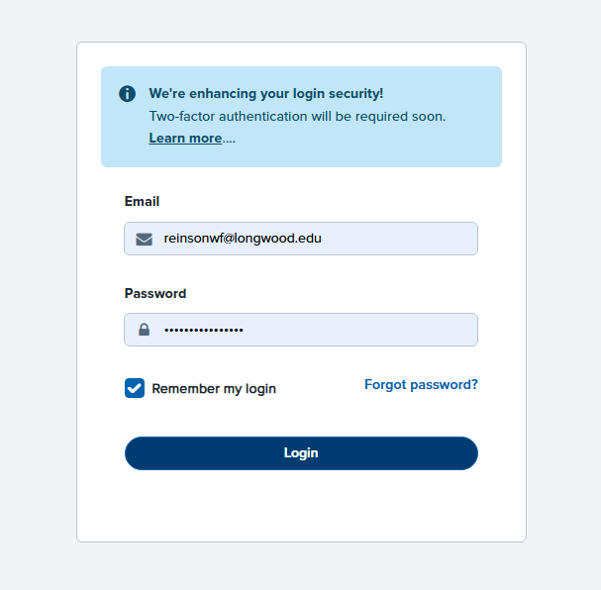
Login Screen
This is what your login screen should look like. Please sign in using the PageUp login you created. Go to the next slide.

Slide 4
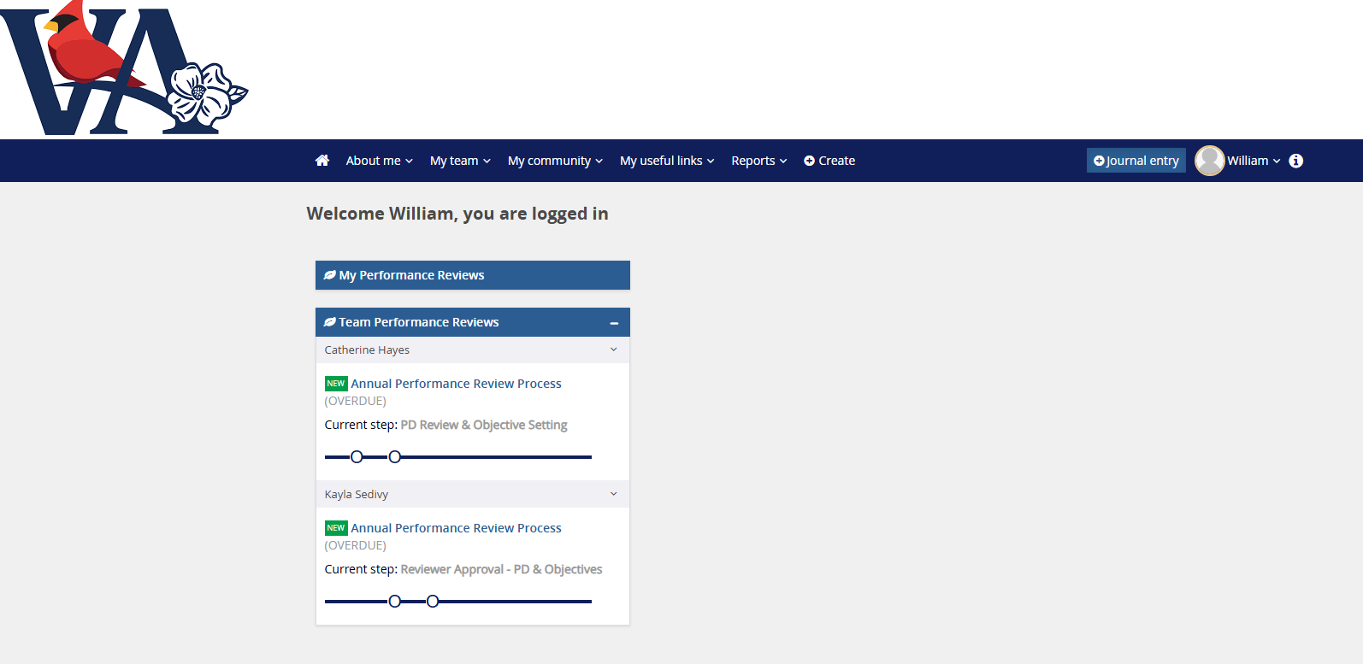
Landing Screen For Performance Reviews
Once signed in, you will be directed here. Your direct reports that have Position Descriptions created will appear here with a live link to their EPP. Please select one, click on it and then go to the next slide.

Slide 5
Employee Performance Profile – Page 1
Jane Doe - Annual Performance Review Process
Start/ Position Description/ Performance Objectives/ Competencies/ Development Plan/ Next steps
Hi Supervisor,
Welcome to Jane Doe’s Employee Performance Profile. What you need to do now: This is the first phase of the performance cycle and is where you will review and update the position description and set the performance objectives and learning goals for this performance cycle.
To access the Position Description Library, click here, Link to Position Description Library. Search for Jane’s position description using their Cardinal position number (e.g. XYZ12345). If a position description doesn't exist, you will need to create one by selecting "New Position Description" at the top left. Please use the content in the existing EWP to create the new position description. You will need to get feedback from Jane on their learning goals so you can update their development plan. What happens next:
Submit the EPP to your supervisor for their review and approval.
Meet with Jane to review the Employee Performance Profile.
Submit to Jane for their acknowledgement.
When the EPP is finalized, we move into phase 2, the ‘Ongoing Feedback’ phase of the performance process. Click on the [Next] button at the bottom of the page to begin.
If you do not want to view or make changes to the PD, please click “Next” in the bottom right corner of the page and go to the next slide. If you need to review or makes changes to the PD prior to beginning the EPP, you can follow the highlighted instructions. The PGD Library will open in a different window, so you may easily return to the EPP. If you want to view the PD, you can click on the view button. To make changes, you can hit the “Edit” button, follow the instructions in the “Creating a PD” slide show and then click the “Update PD” button at the bottom. This will restart the approval process and you will receive an email once it is approved. It should not delay the EPP process. Once completed, go to the next slide.

Slide 6
Performance Objectives Instructions
Jane Doe - Annual Performance Review Process
Start/ Position Description/ Performance Objectives/ Competencies/ Development plan/ Next steps
Performance Objectives
Employee
In the section below, please review the performance objectives established for this performance cycle.
Manager
In the section below, you must add a minimum of 3 and maximum of 5 performance objectives for this performance cycle. The weighting of performance objectives must total 80%. Performance objectives are actionable items that employees are expected to accomplish for this year. When setting performance objectives, be sure to set a relevant measurement for each objective to ensure you know what success looks like and a target date for completion.
Performance objectives should be set using SMART:
Specific: clearly define what you want your employee to achieve
Measurable: set a number or a standard to track their progress
Achievable: set a performance objective that's realistic and within their capabilities
Relevant: make sure the performance objective is important to the employee meeting the agencies objectives
Time-bound: set a deadline for completion
In this situation, you are the “Manager,” so please follow the instructions listed under “Manager.” Keep in mind that the totals must amount to 80%. The remaining 20% will be from Core Competencies, which will be later in the EPP. Go to the next slide.

Slide 7
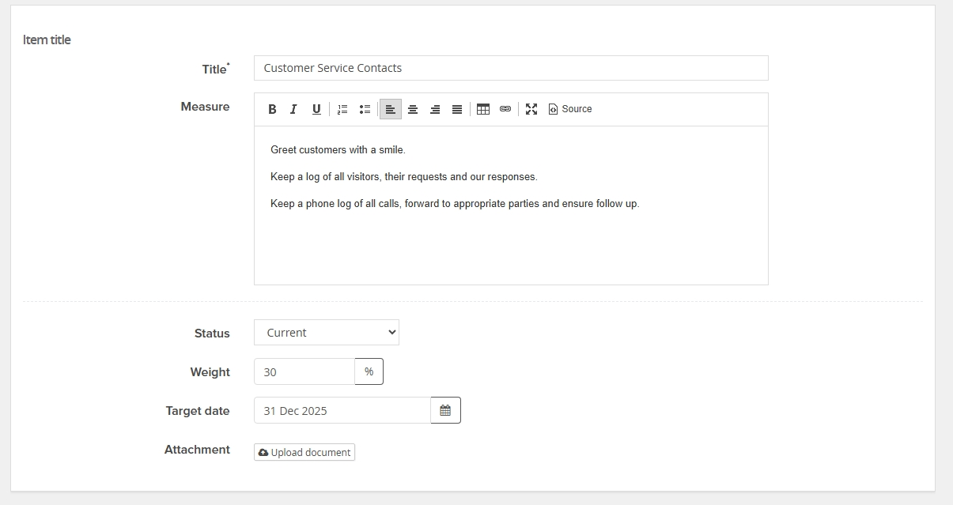
Sample #1 Objective
Enter the title of the objective in the “Title” box. In the “Measure” box, add specific measures of how to achieve the objective. The status should be “Current.” As the manager, you decide the weight of each objective. As a reminder, the total of the objectives should be 80%. The target date for this review will be December 31, 2025. If you would like to attach documents, use “Upload Document.” Go to the next slide.

Slide 8
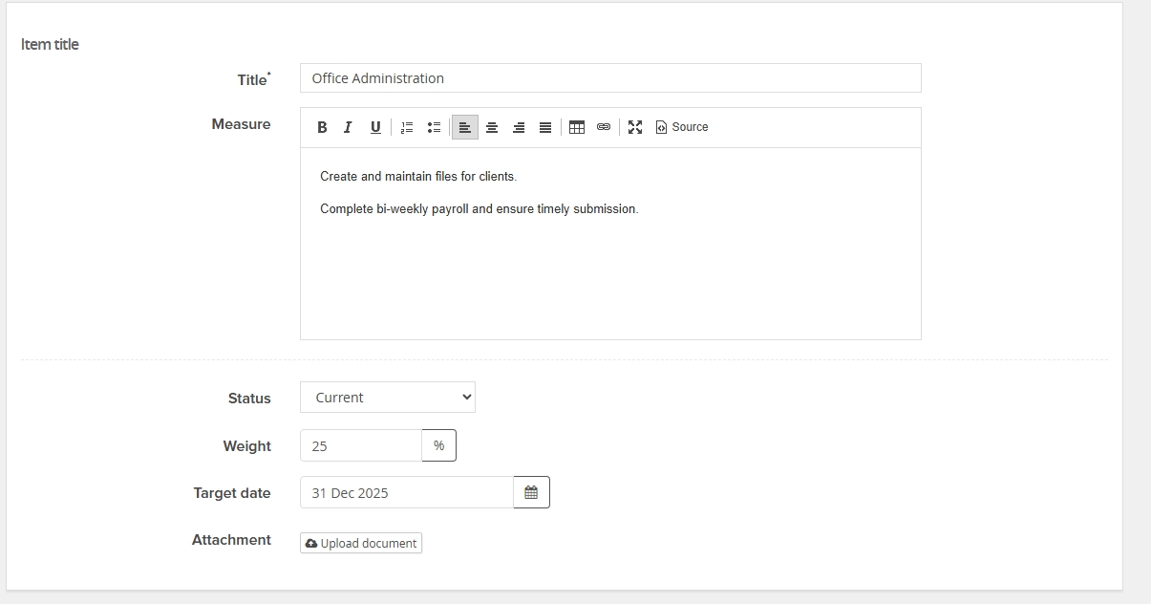
Sample #2 Objective
Enter the title of the objective in the “Title” box. In the “Measure” box, add specific measures of how to achieve the objective. The status should be “Current.” As the manager, you decide the weight of each objective. As a reminder, the total of the objectives should be 80%. The target date for this review will be December 31, 2025. If you would like to attach documents, use “Upload Document.” Go to the next slide.

Slide 9
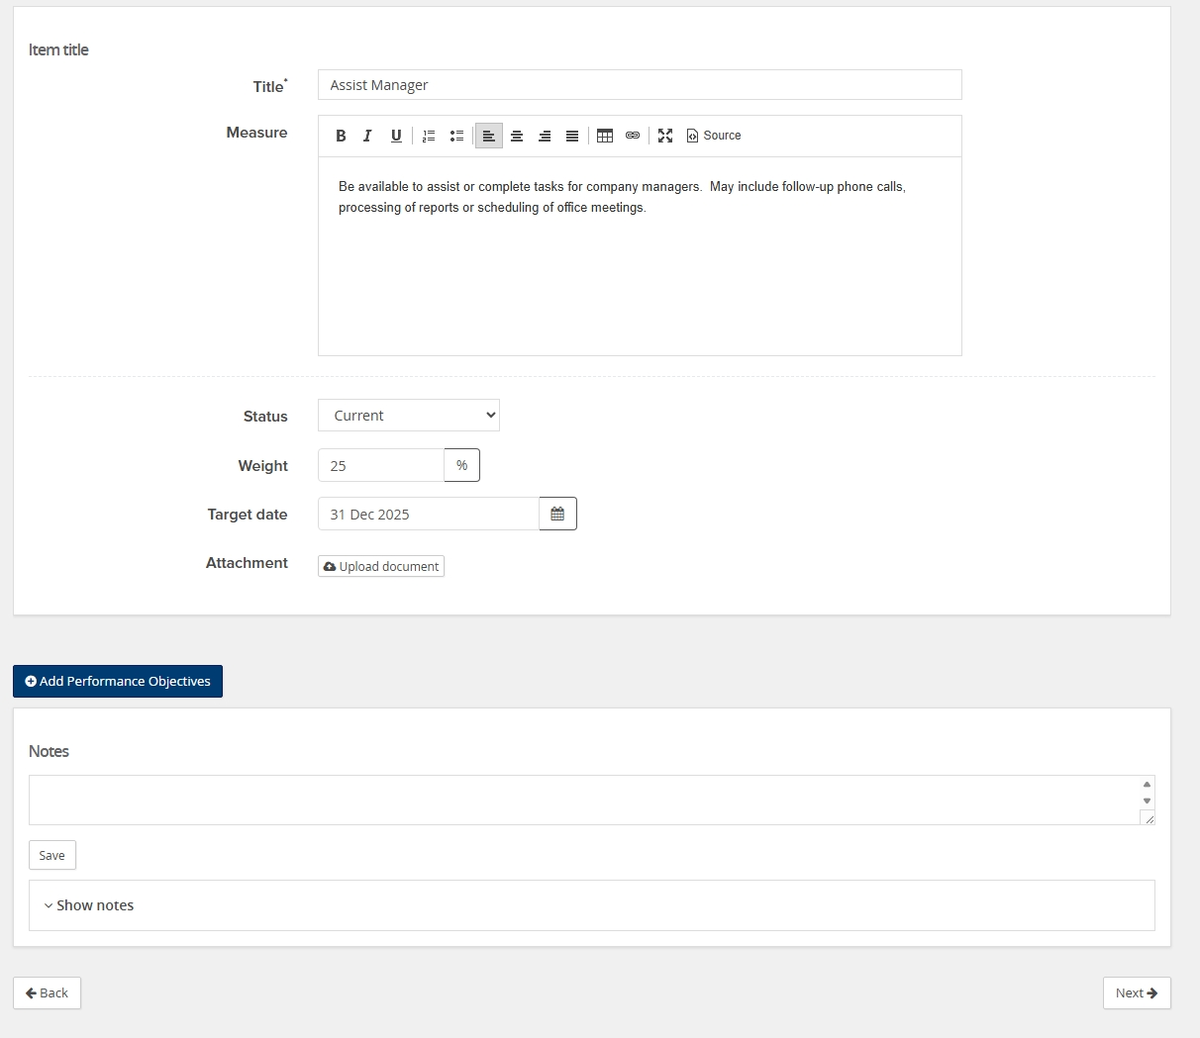
Sample #3 Objective
Utilize the “Add Performance Objectives” button to add additional objectives (max of 5). Once you have completed the objectives, click the “Next” button in the lower right hand corner of the page and go to the next slide.

Slide 10
Description of Core Competencies
Jane Doe - Annual Performance Review Process
Start/ Position Description/ Performance Objectives/ Competencies/ Development plan/ Next steps
Competencies
Competencies are the attributes and behaviors that are demonstrated by the employee in performing their job. The weighting of competencies is prescribed and totals 20%. During the evaluation phase, the employee and supervisor will have the opportunity to evaluate and rate each of the competencies below. Take this time to familiarize yourself with these competencies.
Problem Solving, Judgment, Planning and Organization Weight: 5%
Measure
Identifies workplace challenges, works to resolve them and takes responsibility for decisions. Understands the Commonwealth’s purpose and mission. Plans, organizes, manages time and works in support of the Commonwealth’s mission, vision and values. Takes initiative and self-leadership to achieve desired outcomes. Adapts to changes in the workplace.
Defines and develops potential solutions to problems/ issues
Implements solutions/ programs effectively
Takes responsibility for actions
Considers cost, benefits and risks when making and implementing decisions
Anticipates potential problems and adapts to changes in the workplace
Responds to both internal and external forces affecting the community
Organizes and prioritizes work; uses time and resources wisely
Demonstrates resiliency
Seeks opportunities for performance improvement and development
Attachment
There are four Core Competencies that account for 20% of the EPP. These are the same for every classified employee and determined by DHRM. You will evaluate the employees on these later in the process. Go to the next slide.

Slide 11
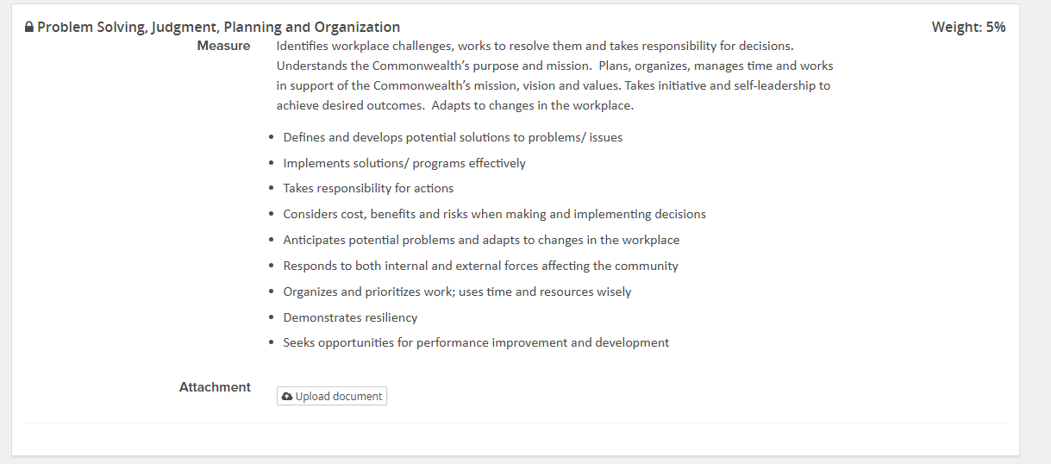
Core Competency #1
There are four Core Competencies that account for 20% of the EPP. These are the same for every classified employee and determined by DHRM. You will evaluate the employees on these later in the process. Go to the next slide.

Slide 12
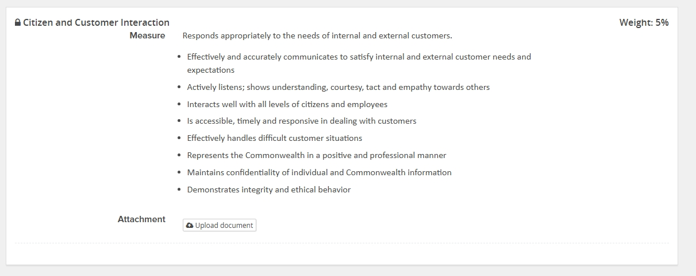
Core Competency #2
There are four Core Competencies that account for 20% of the EPP. These are the same for every classified employee and determined by DHRM. You will evaluate the employees on these later in the process. Go to the next slide.

Slide 13
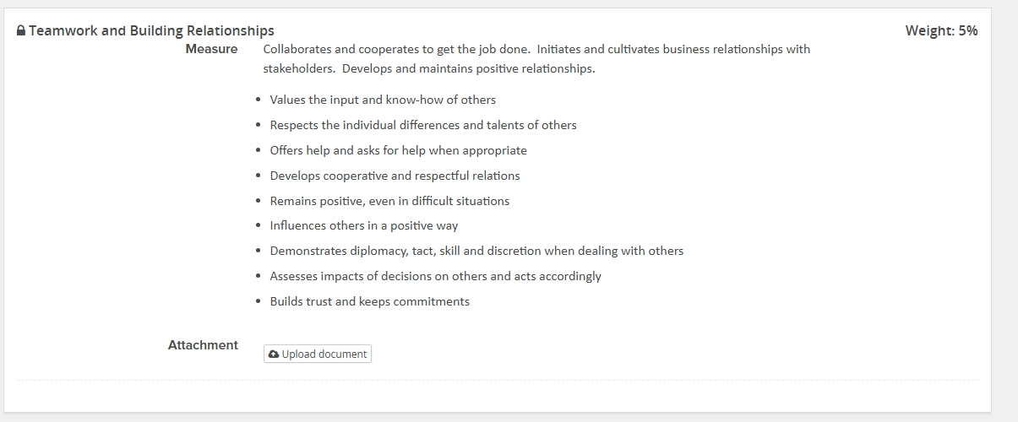
Core Competency #3
There are four Core Competencies that account for 20% of the EPP. These are the same for every classified employee and determined by DHRM. You will evaluate the employees on these later in the process. Go to the next slide.

Slide 14
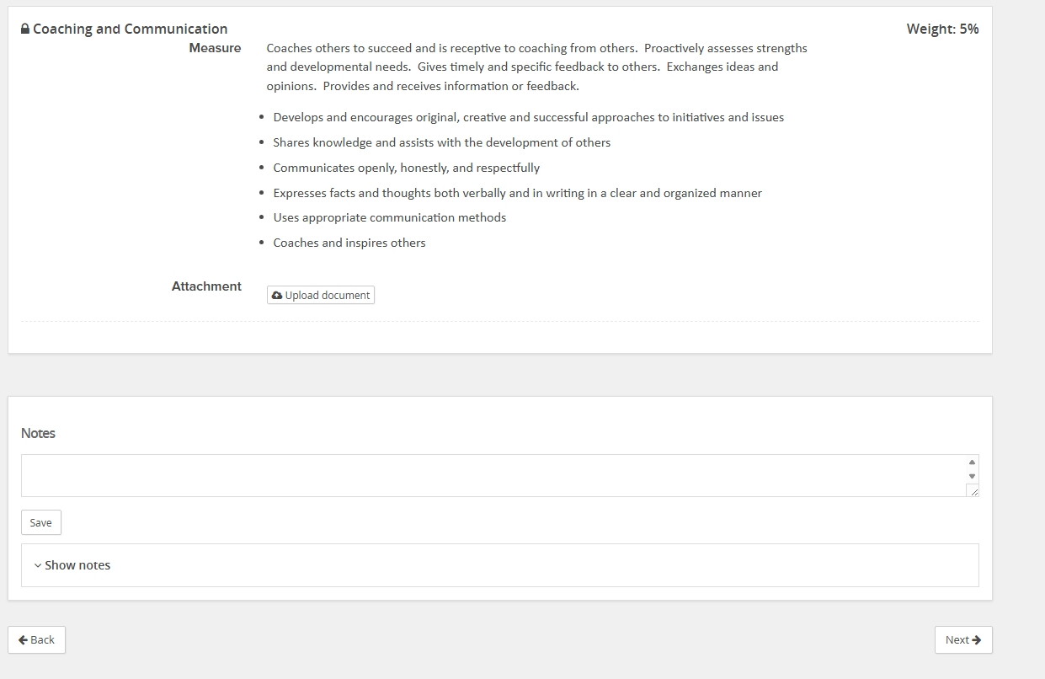
Core Competency #4
Once you get to this point, click “Next” at the bottom right of the screen and go to the next slide.

Slide 15
Development Plan Description
Jane Doe - Annual Performance Review Process
Start/ Position Description/ Performance Objectives/ Competencies/ Development plan/ Next steps
Development plan
Personal Learning Goals: List any learning goals identified by the supervisor and/or employee.
Learning Steps/Resource Needs: Indicate specific steps that need to be taken to accomplish the learning goals. This may include training, coaching, or other learning methods.
Personal Learning Goals
Learning Steps/Resources Needed
Follow these directions to add personal learning goals to the EPP. Go to the next slide.

Slide 16
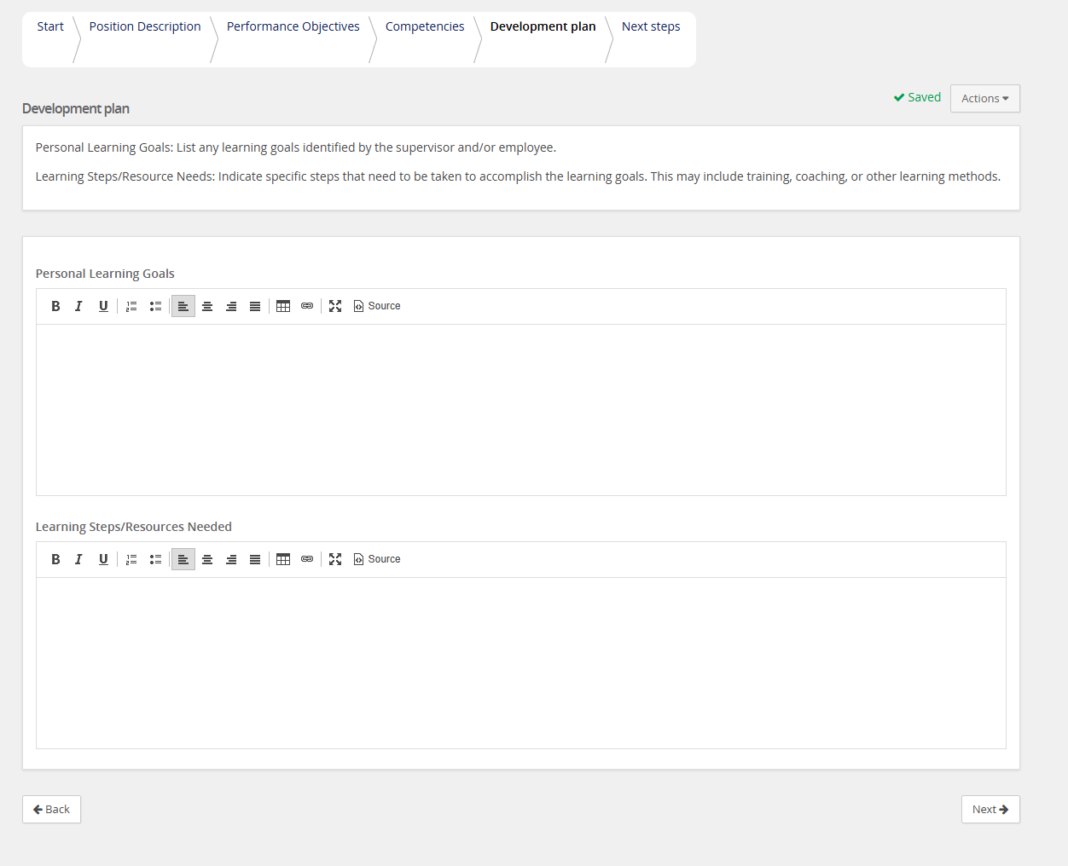
Development Goal Page
Please enter any Personal Learning Goals or Learning Steps/Resources on this page. When complete, click “Next” at the bottom right of the page and go to the next slide.

Slide 17
Annual Performance Review Process
Jane Doe - Annual Performance Review Process
Start/ Position Description/ Performance Objectives/ Competencies/ Development plan/ Next steps
Thanks for setting the Employee Performance Profile for Jane Doe. This EPP will be sent to your supervisor for their review and approval.
After reviewer approval, please send to Jane for their review and acknowledgement.
Once Jane acknowledges the EPP, it will be available in the 'Ongoing feedback' phase. As a supervisor, you are encouraged to engage in collaborative performance discussions. You can do this by posting comments or attaching relevant files in the journal that relate directly to Jane’s EPP job duties, performance objectives, competencies and development plan. Jane can also use and view the journal to post comments or attach relevant files related to their EPP.
Summary
Summary
Position Description
Performance Objectives
Competencies
Your next step: Reviewer Approval - PD & Objectives
Clicking "Go to next step" will move this review to the next step and you will be unable to return to this step
View entire process
You have now completed the first step in the EPP process. The EPP has been forwarded to your supervisor (Reviewer) for review. You will receive an email notifying you when they have approved the EPP.

Slide 18
Example Email to Supervisor for Review
From: COV Performance Team <noreply-1125@mail.pageuppeople.com> Sent: Thursday, August 21, 2025 10:19 AM To: (Reviewer) Subject: Review Employee Performance Profile
Hi Reviewer,
You are reviewing and approving the Employee Performance Profile for Jane Doe completed by Supervisor for this performance cycle.
What you need to do now:
This is your opportunity to review the position description, performance objectives, competencies and development plan for Jane.
What happens next:
After logging in, hover over "My Team" tab at the top, click "Performance Reviews", find Jane’s review and click "Open Review."
Review the EPP. If you have any questions or changes, please discuss with Manager 1.
Click on the "Go to next step" button on the final page to provide your approval.
To log into Jane’s Employee Performance Profile click on the following link:
COV network users: click Login to Employee Services.
Non-COV network users: click Login to Employee Services - non COV network
Please contact your Agency HR Department with any questions.
Reviewer, please follow the directions on this email to review/change/add to the EPP. Click “Go to Next Step” button to approve and send the EPP back to the manager.

Slide 19
Example Email After Supervisor (Reviewer) Approval
From: COV Performance Team <noreply-1125@mail.pageuppeople.com> Sent: Thursday, August 21, 2025 4:46 PM To: Supervisor Subject: Meet with Employee to Review EPP
Dear Supervisor,
Your supervisor (Reviewer) has completed their review of the Employee Performance Profile (EPP) for Jane Doe.
What you need to do now:
Review EPP for any changes made by your supervisor (Reviewer).
Schedule a meeting with Jane Doe to review their EPP.
Click "I agree" on the Next Steps page to send the EPP to Jane Doe.
To access Jane Doe’s EPP:
COV network users: click Login to Employee Services.
Non-COV network users: click Login to Employee Services - non COV network
If you have any questions, please contact your Agency HR.
Email received after the Reviewer has approved the EPP. Follow the instructions listed above to send the EPP to the employee.

Slide 20
Final Steps- Meet with Employee

